Slide 1

EECT122
By: Eh Doh Lwe
Instructor: Andrew Bell

Slide 2
Table of contents
Lab 0 – 74LS08 test design, build and test
Lab 1- 74LS08s and 74LS32 – design build and test a 3 input “AND” and “OR”
Lab 2 – Design build and test a NAND gate latch
Lab 3 – Design, build and test a SR FF
Lab 4 - Design, build and test a D FF
Lab 5 - Design, build and test a JK FF
Lab 6 – Simulated, built and test the 74LS283 2’s complement and 4 bit adder
Lab 7 – Design, built and test a 4 counter (synchronous)
Lab 8 – Design, built and test a Mod 12
Lab 9 - Boolean Reduction – simulation and simplification
Lab 10 - 74185 Model development
Lab 11 – Binary to 7 segment display
Lab 12 – Xilinx CPLD effort
Lab 13 – Arduino Labs
Lab 14 – Arduino part 2
Lab FF – develop a schematic for Lou’s box

Slide 3

Lab- 0

Slide 4
Objectives:
Using Multisim build and upload a sim file that fully tests a 74LS08.
Build 74LS08 test circuit in lab.

Slide 5
Equipment and Parts:
5 Volt DC Power Supply
Digital Multimeter
Breadboard
Wires
74LS08
LED
Switch
2 10k Resistors
Digital Multimeter
Brand: GW instek
Model #: GDM8245
SN: CL860336
DC Power Supply
Brand: RSR
Model #: HY1802D
SN: 369996

Slide 6
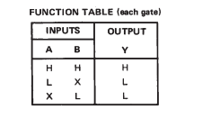
Theories:

Slide 7
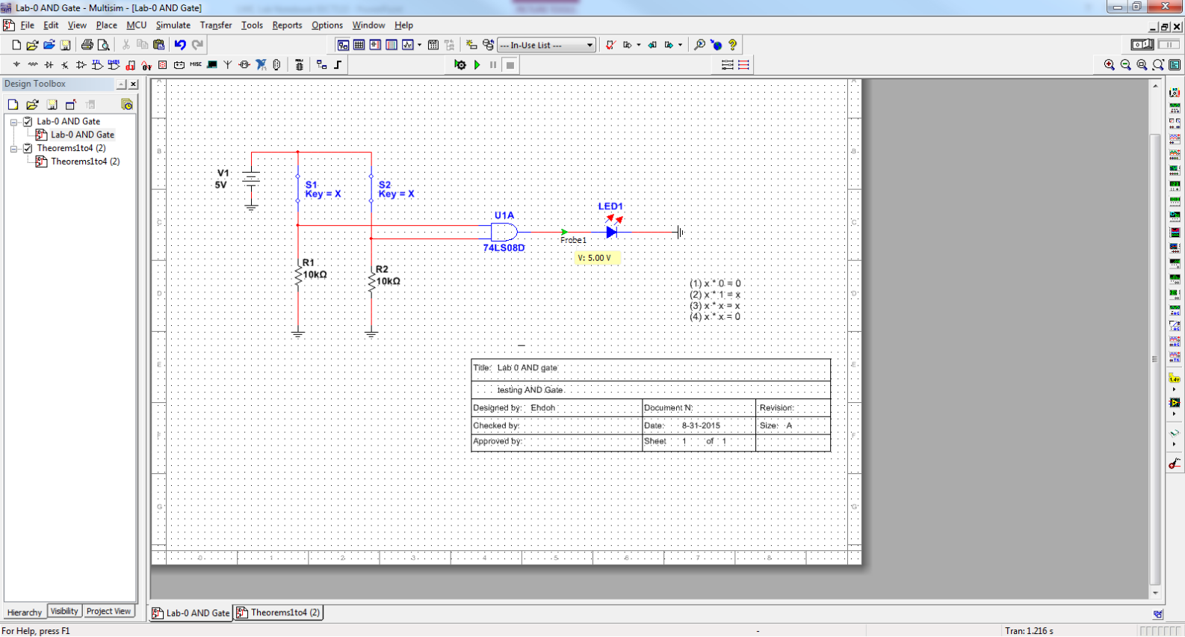
Data/Lab Results/Simulations/Schematics:

Slide 8
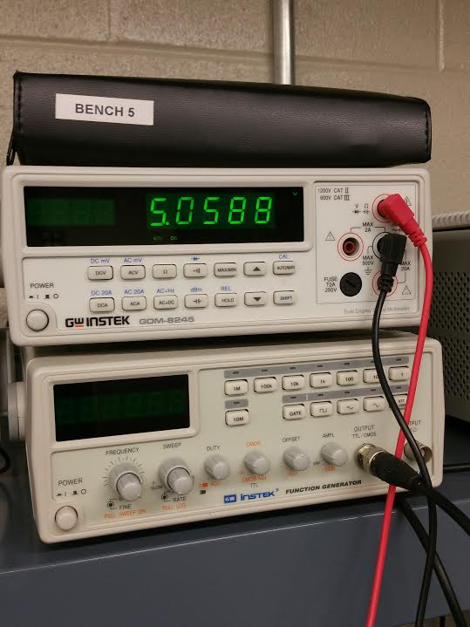
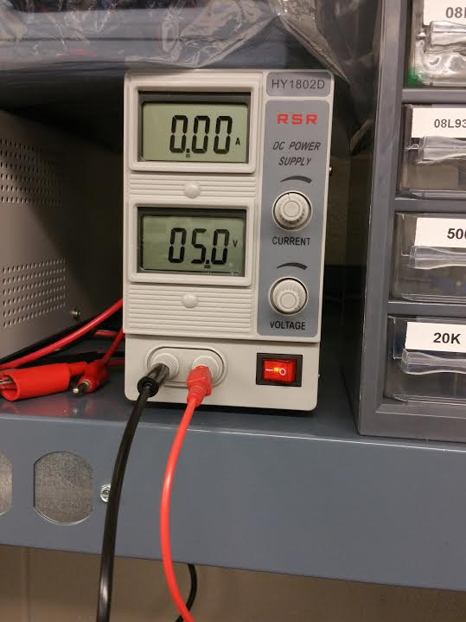
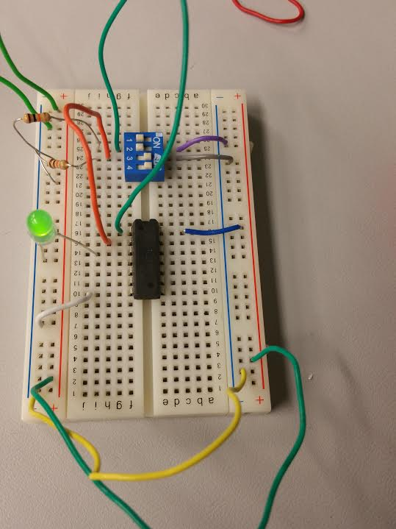
Pictures
Power measure on DMS
A complete wired up circuit

Slide 9
Troubleshooting:
Didn’t work the first time I hooked it up without the switch which made it looked messy and confusing to figure out what I did wrong.
I used Multimeter to troubleshoot it but couldn’t figure out what was wrong so I placed in a switch rewired up the whole thing.
Even with a switch, it still didn’t work but later found out that I wired it up wrong. There wasn’t power going to VCC on IC because the wire was grounded instead of coming from the power.

Slide 10
Conclusion:
This was an easy lab which was a review from EECT112. Didn’t thought that It would take me long to wired it up and get the lab done but it took me awhile because it didn’t work which I had to troubleshoot it to make it work.

Slide 11
Data Sheets:
http://ivytechengineering.com/stores/74ls/files/74ls08.pdf

Slide 12

Lab- 1

Slide 13
Objectives:
Design, Build and Test a three input AND gate using two input AND gates. Design, Build and Test a three input OR gate using two input OR gates.

Slide 14
Equipment and Parts:
5 Volt DC Power Supply
Breadboard
Wires
74LS08, 74LS32
LED
Switch
(3) 10k Resistors
DC Power Supply
Brand: RSR
Model #: HY1802D
SN: 369996

Slide 15
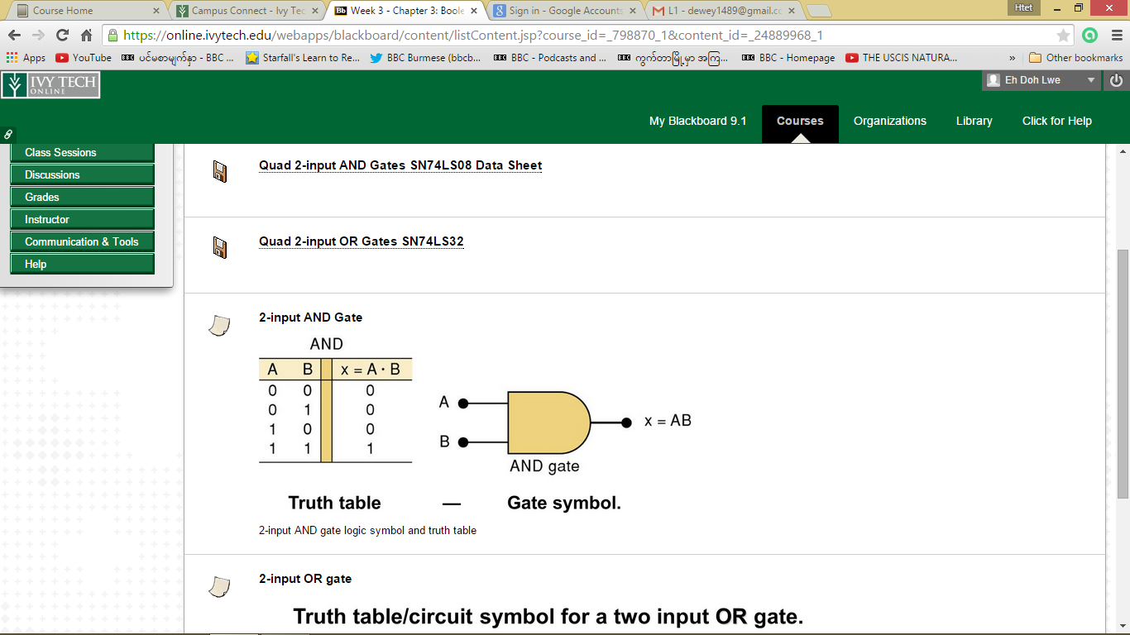
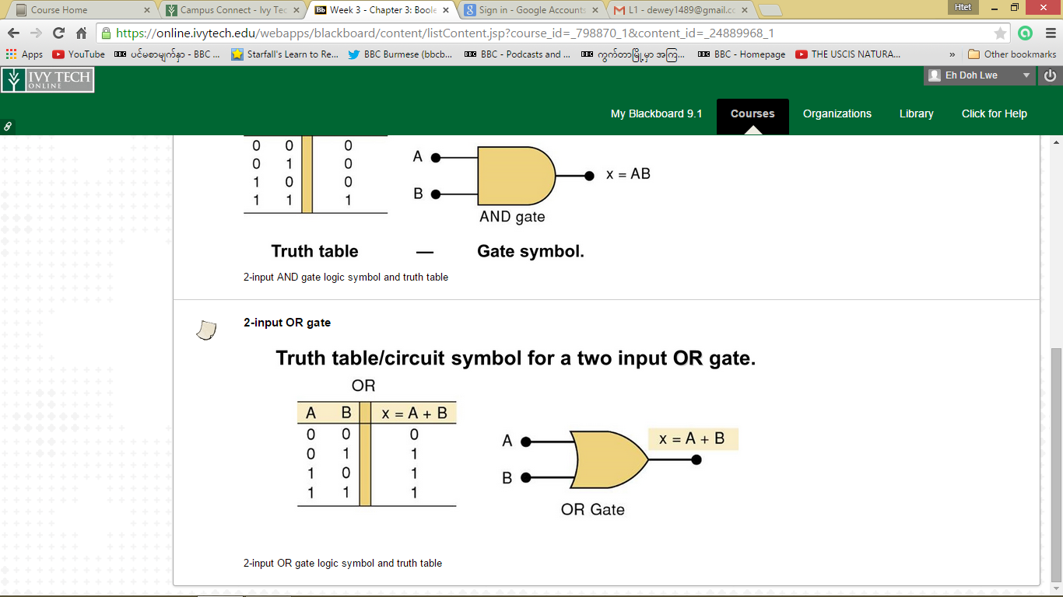
Truth Table

Slide 16
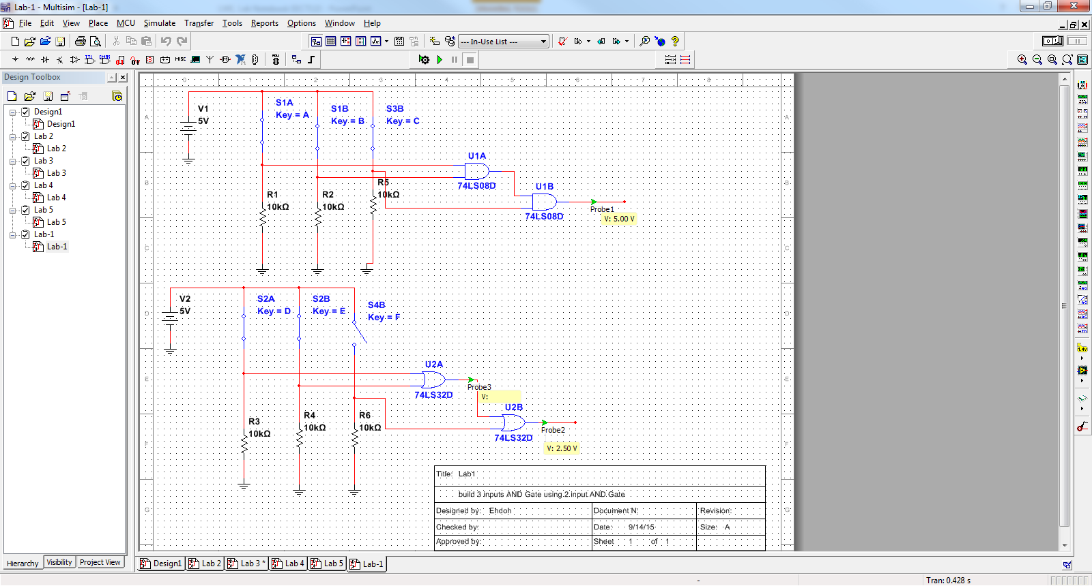
Schematic

Slide 17
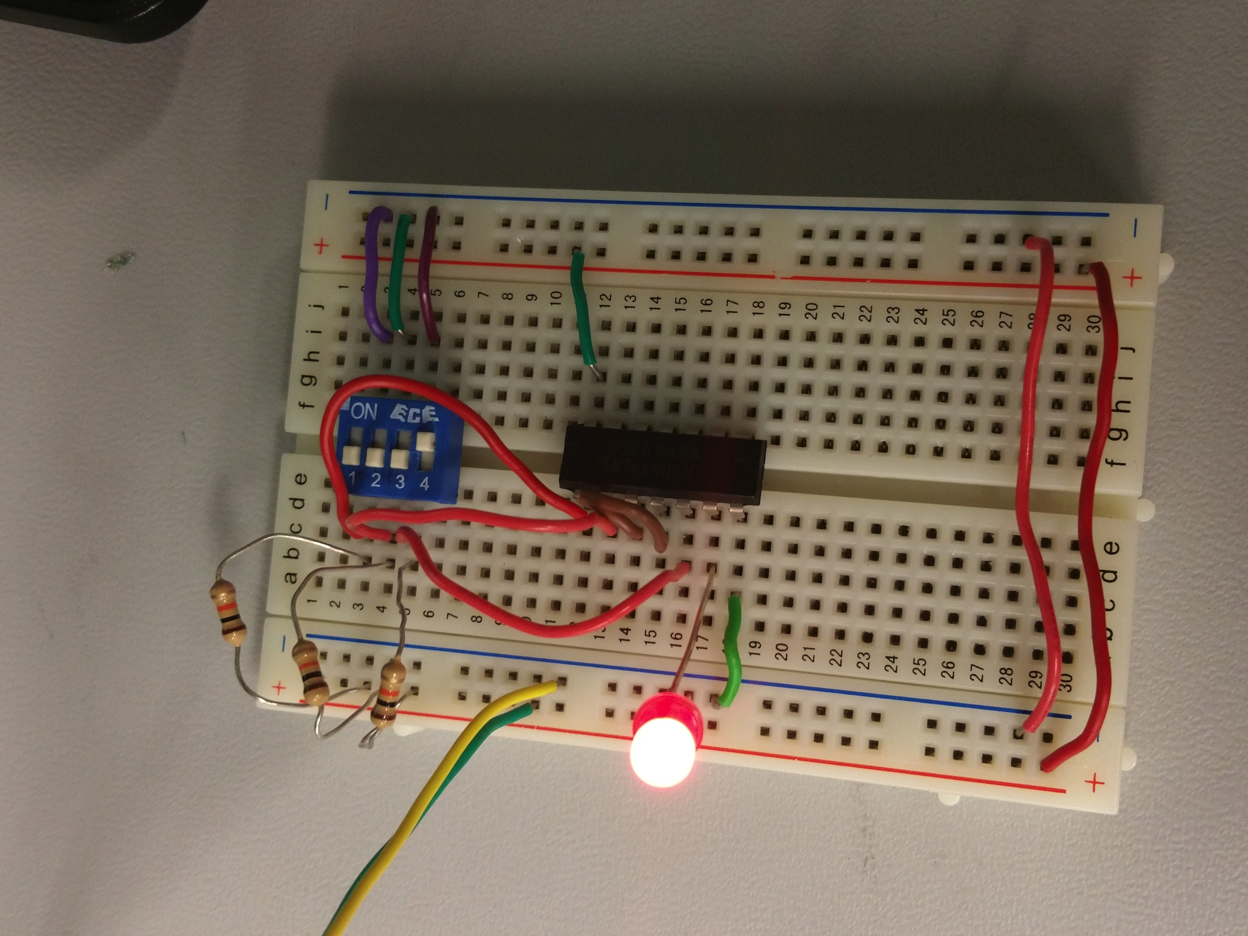
Picture

Slide 18
Conclusion
This was a review from EECT112 so it didn’t take me long to build it in Multism and build it on the breadboard.
I didn’t have to look at the datasheet at all for the pins because I could still remembered them from EECT112 but I did pulled up the datasheet to make sure I was right.
Overall, the circuit worked as expected.

Slide 19

Lab- 2

Slide 20
Objectives:
Design, Build and Test a NAND Gate Latch.

Slide 21
Equipment and Parts:
5 Volt DC Power Supply
Oscilloscope
Breadboard
Wires
74LS00
LED
Switch
(3) 10k Resistors
DC Power Supply
Brand: RSR
Model #: HY1802D
SN: 369996

Slide 22
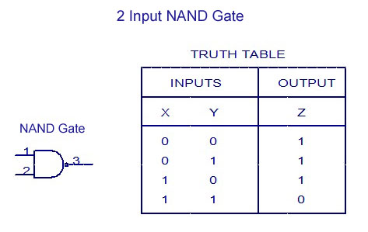
Truth Table

Slide 23
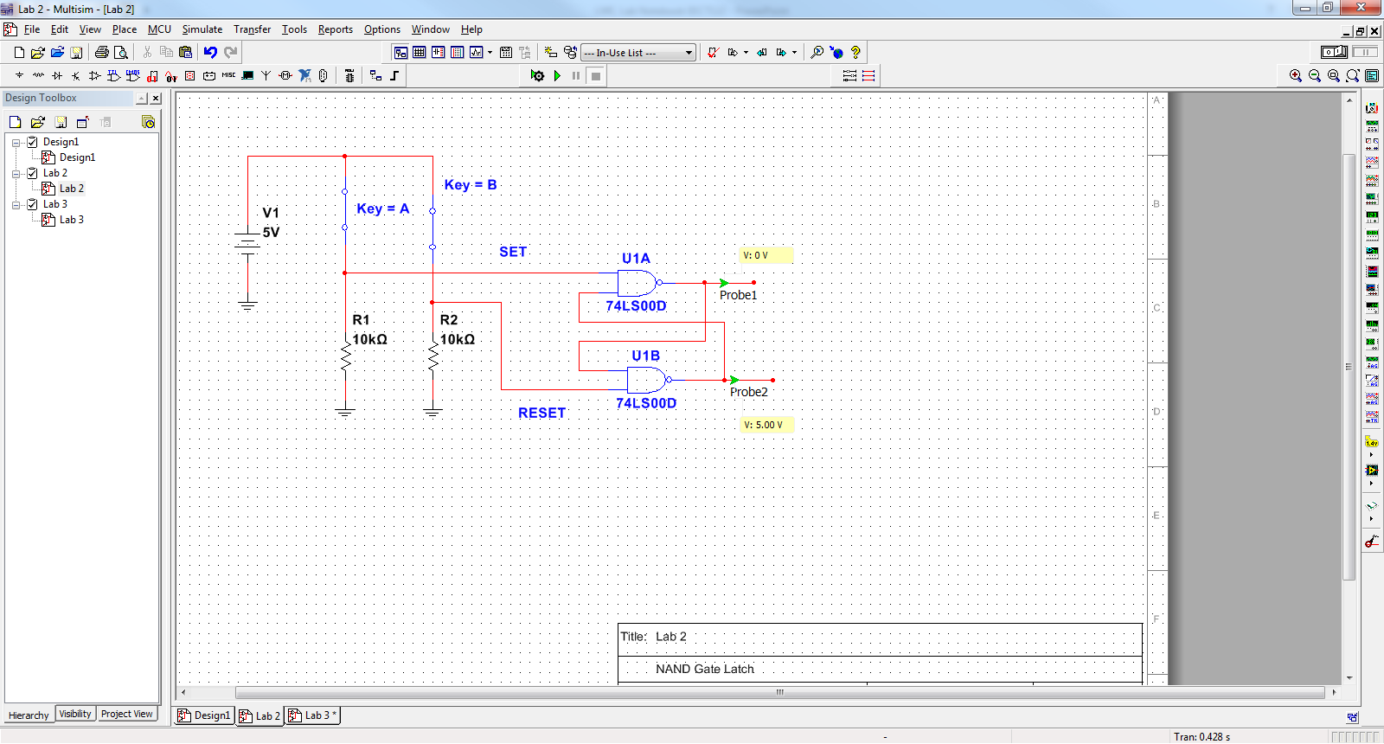
Schematic

Slide 24
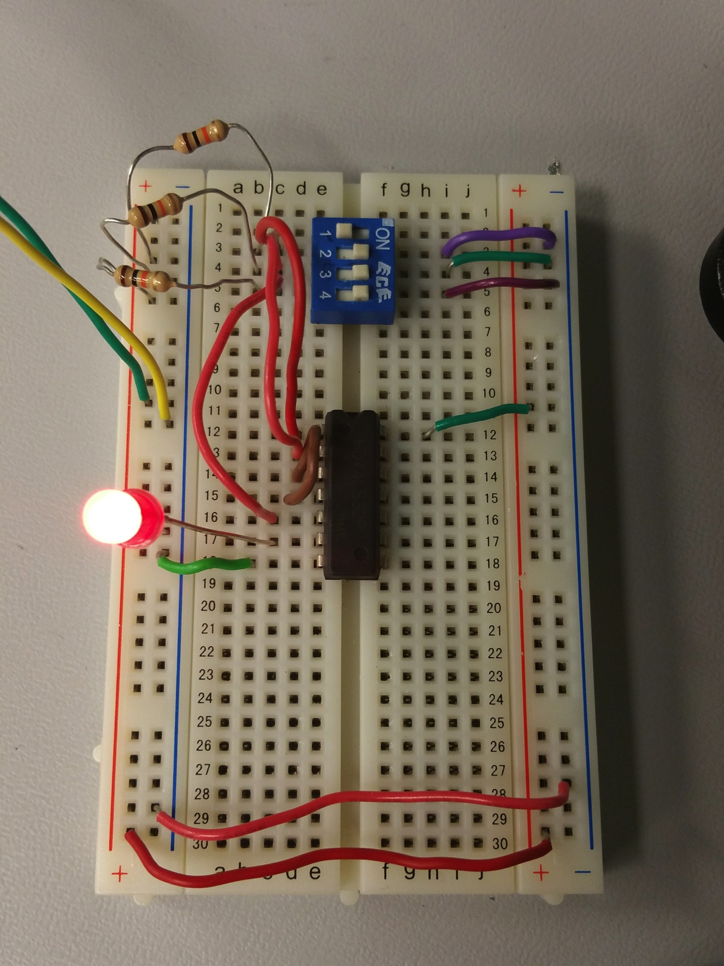
Picture

Slide 25
Conclusion
Wired up the circuit and the results was as expected.
The only problem I have on this was that I’m not quite sure how to read/look at the Oscilloscope and I really need more time on it and also not quite sure the purpose of it.
What I’ve learned from this lab was that logic high with LED has lower voltage drop than without LED connected because some of the voltage is driving the LED.

Slide 26

Lab- 3

Slide 27
Objectives:
Design, Build and Test a SR Latch.

Slide 28
Equipment and Parts:
5 Volt DC Power Supply
Oscilloscope
Function Generator
Breadboard
Wires
74LS00
LED
Switch
(3) 10k Resistors
DC Power Supply
Brand: RSR
Model #: HY1802D
SN: 369996

Slide 29
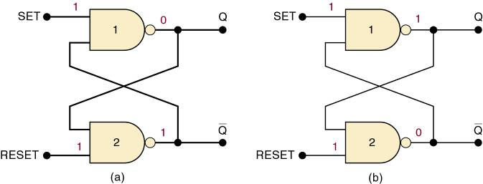
Information about a Latch
Summary of the NAND latch:
  SET = 1, RESET = 1—Normal resting state, outputs remain in state they were in prior to input.
  SET = 0, RESET = 1—Output will go to Q = 1 and remains there, even after SET returns HIGH.
    Called setting the latch.
  SET = 0, RESET = 0—Will produce Q = 0 LOW and remains there, even after RESET returns HIGH.
    Called clearing or resetting the latch.
  Inputs are SET and CLEAR (RESET).
Inputs are active-LOW—output will change when the input is pulsed LOW.

Slide 30
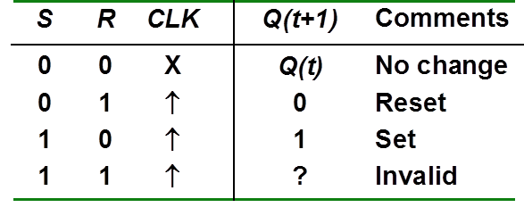
Truth table

Slide 31
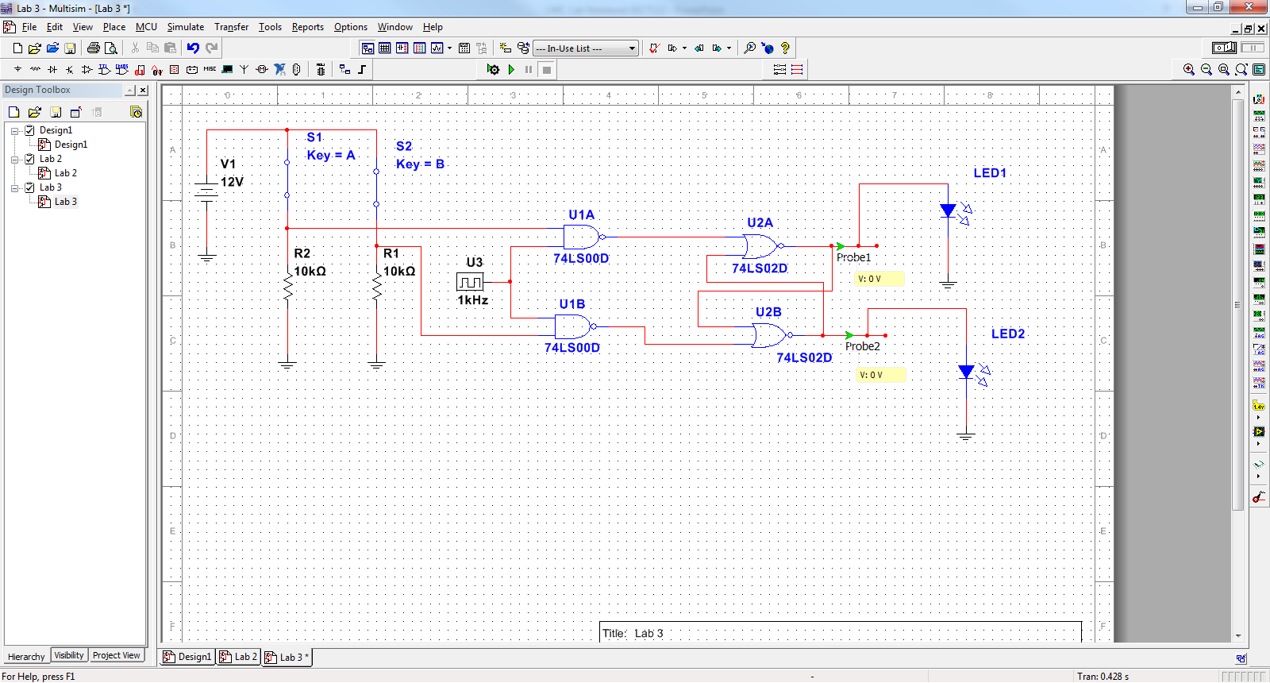
schematic

Slide 32
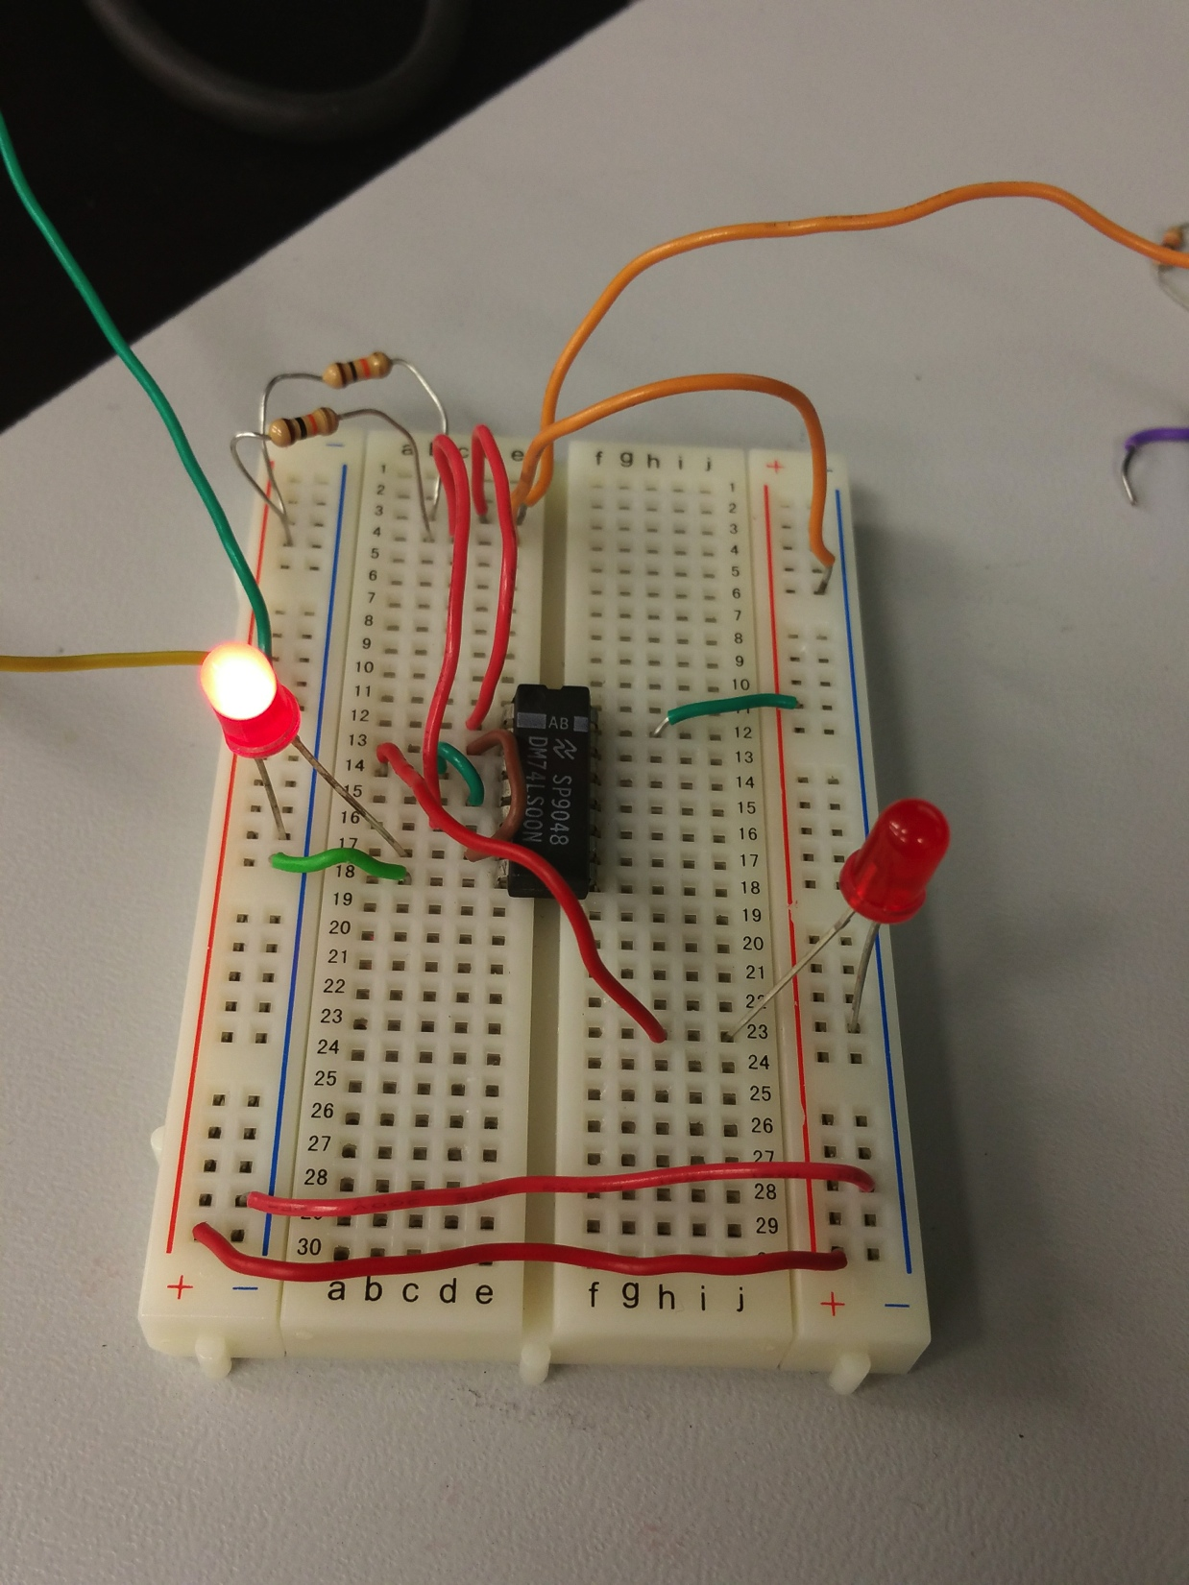
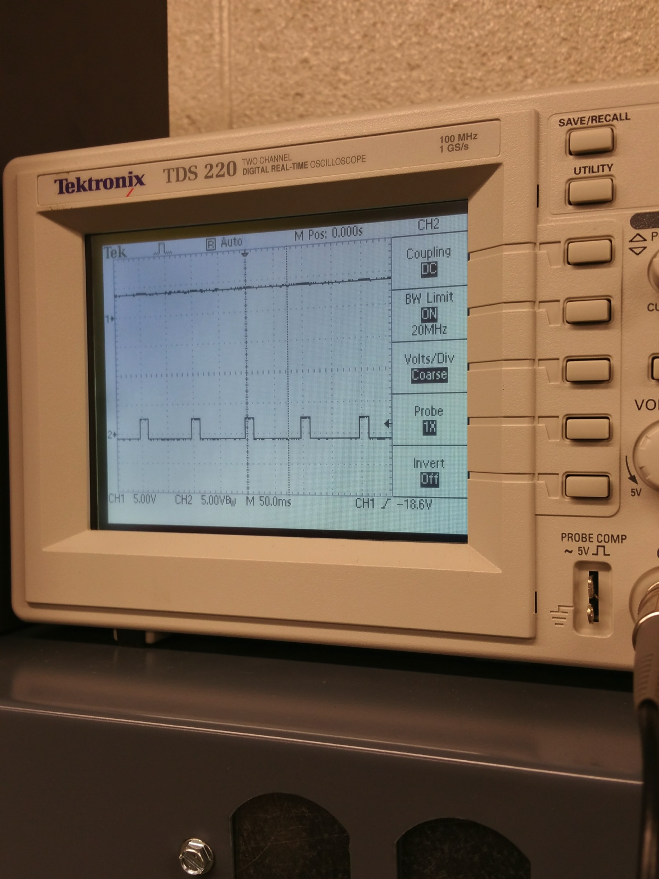
Pictures

Slide 33
Conclusion
  Learning how latches or flip flops works.
The Q and not Q ouputs are supposed to be in opposite states because if both output equal to 1 then the results in both would be 0.
Activation of the S input sets the circuit, while activation of the R input resets the circuit. If both S and R inputs are activated simultaneously, the circuit will be in an invalid condition.

Slide 34

Lab- 4

Slide 35
Objectives:
Design, Build and Test a D Flip Flop Lab.

Slide 36
Equipment and Parts:
5 Volt DC Power Supply
Oscilloscope
Function Generator
Breadboard
Wires
74LS00
LED
Switch
(3) 10k Resistors
DC Power Supply
Brand: RSR
Model #: HY1802D
SN: 369996

Slide 37
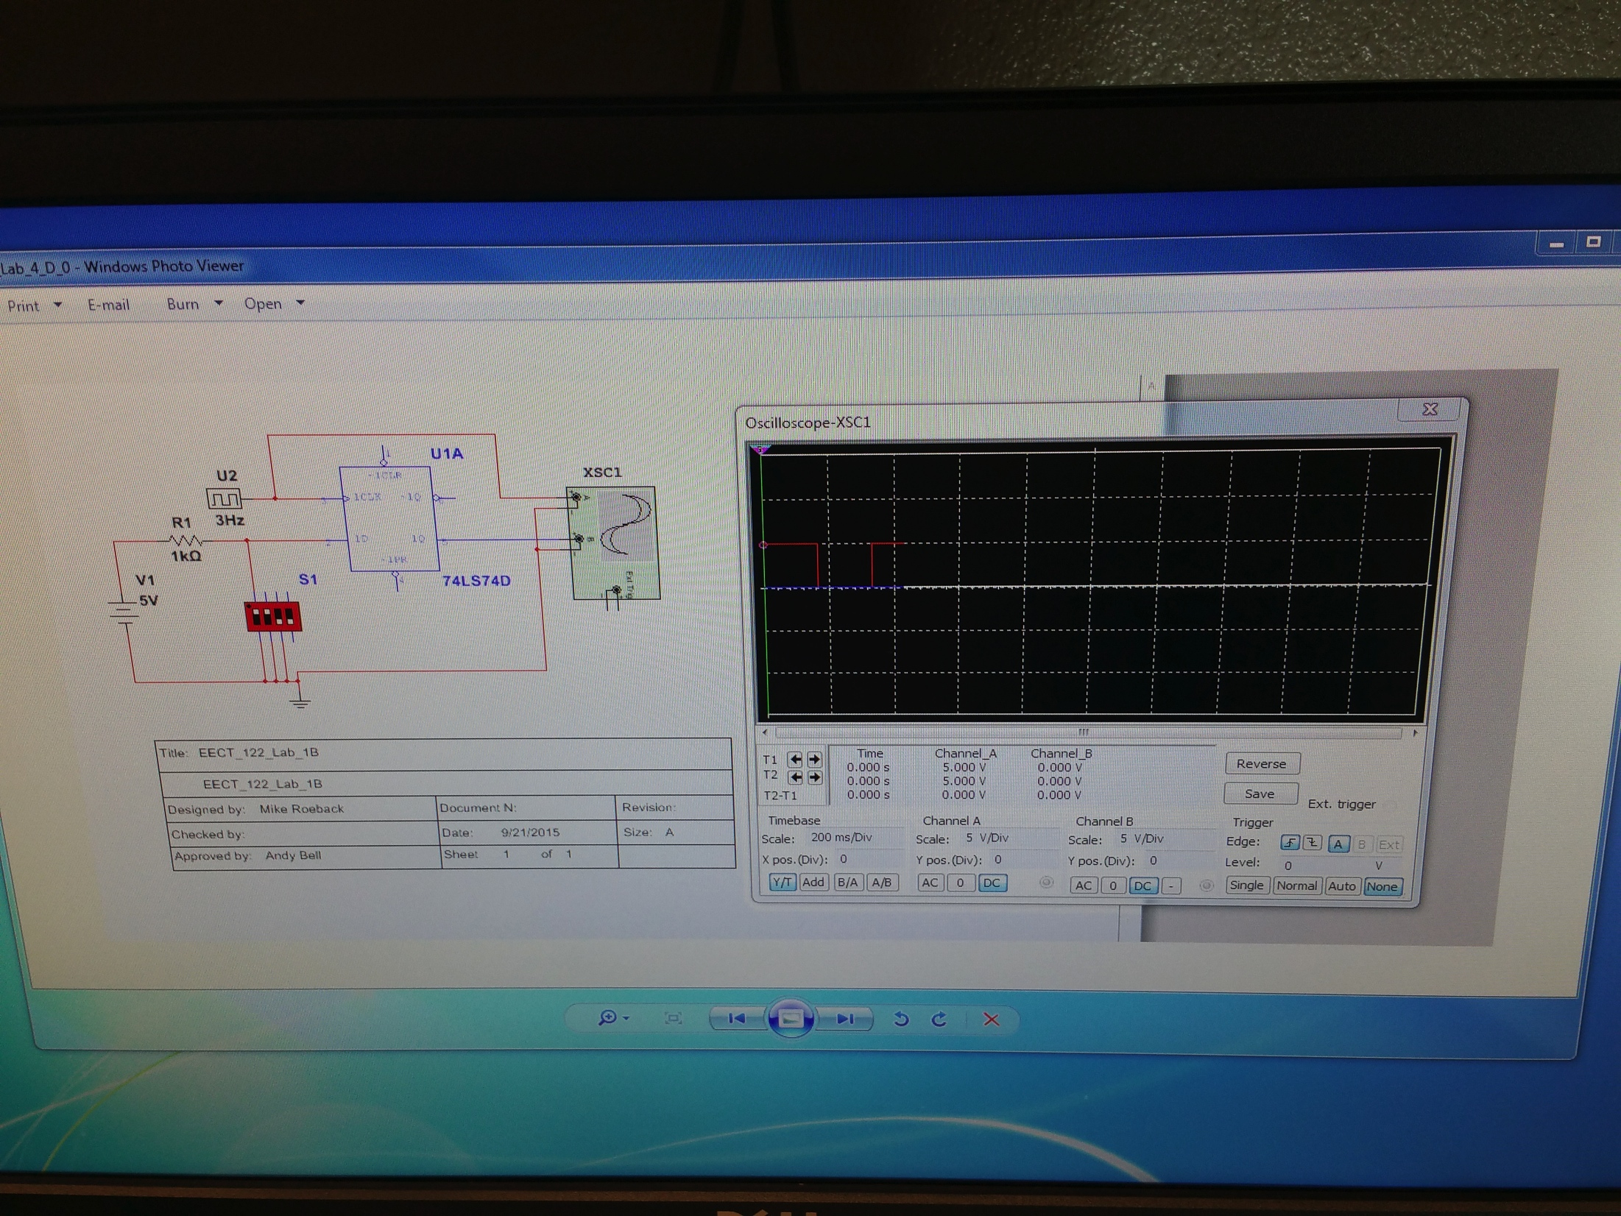
schematic

Slide 38
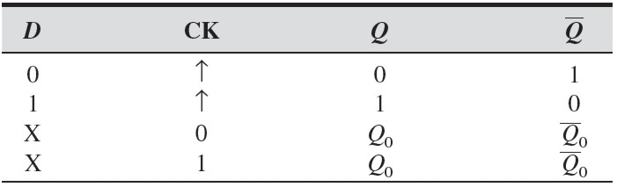
Truth table

Slide 39
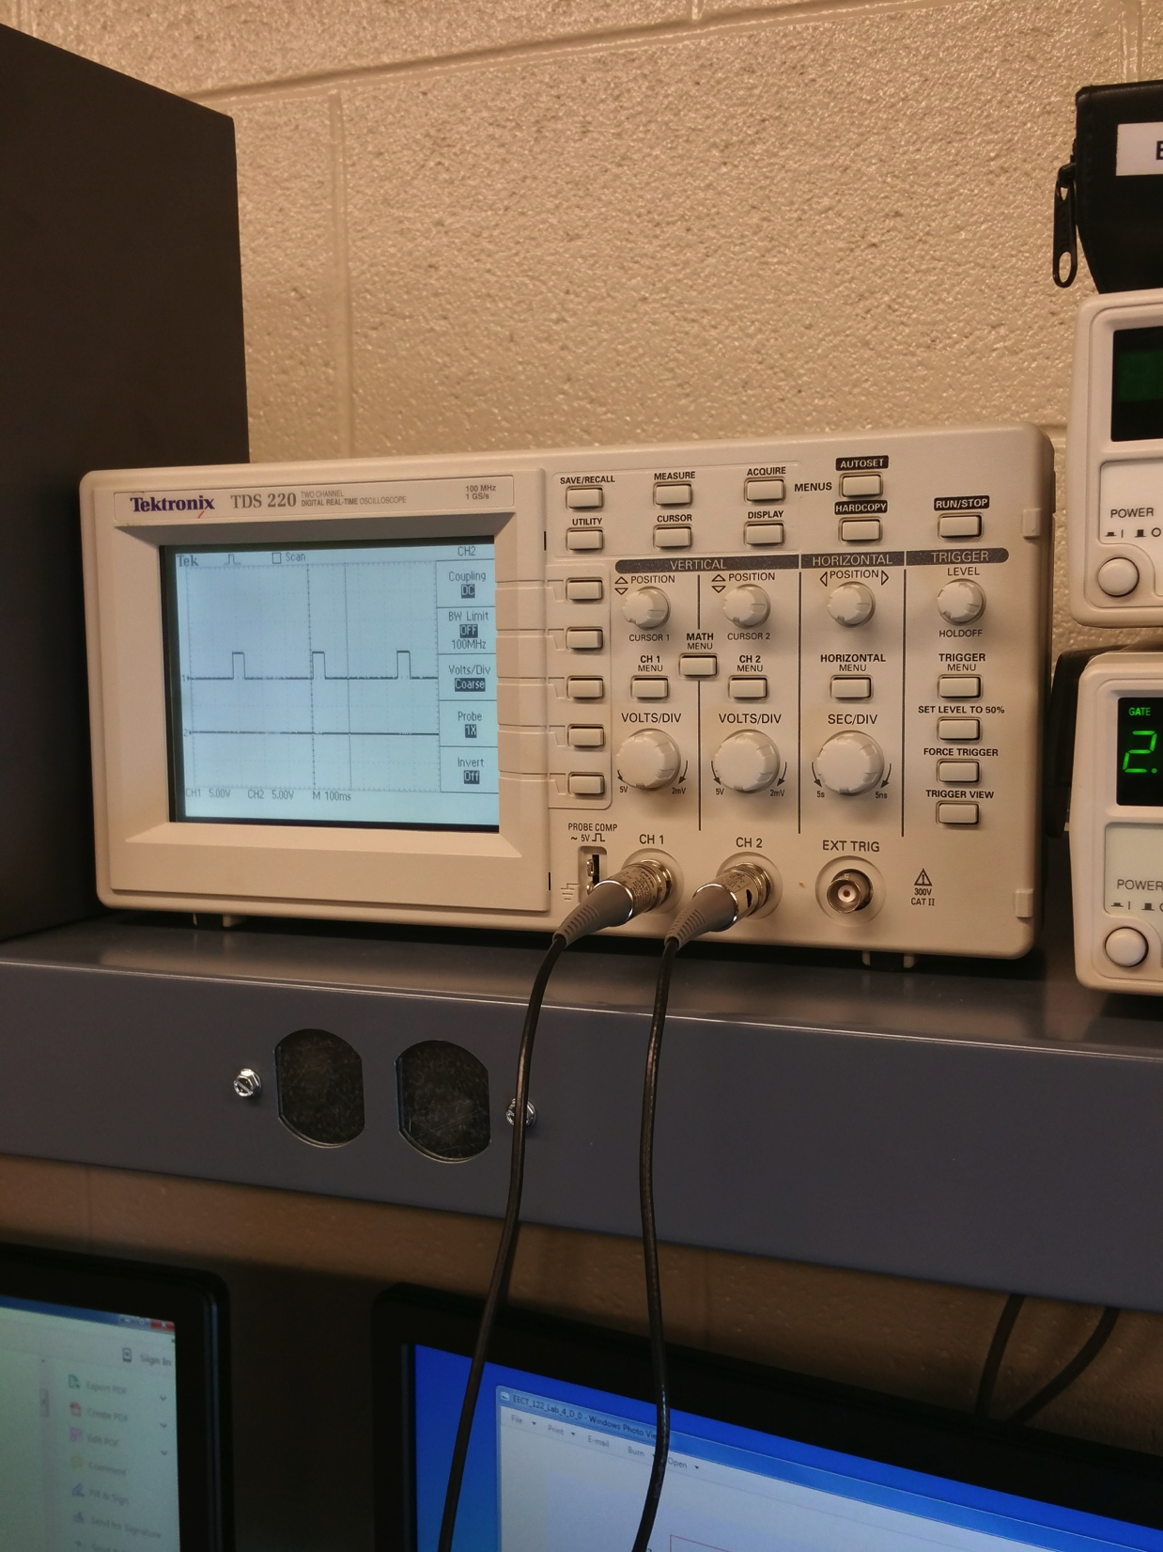
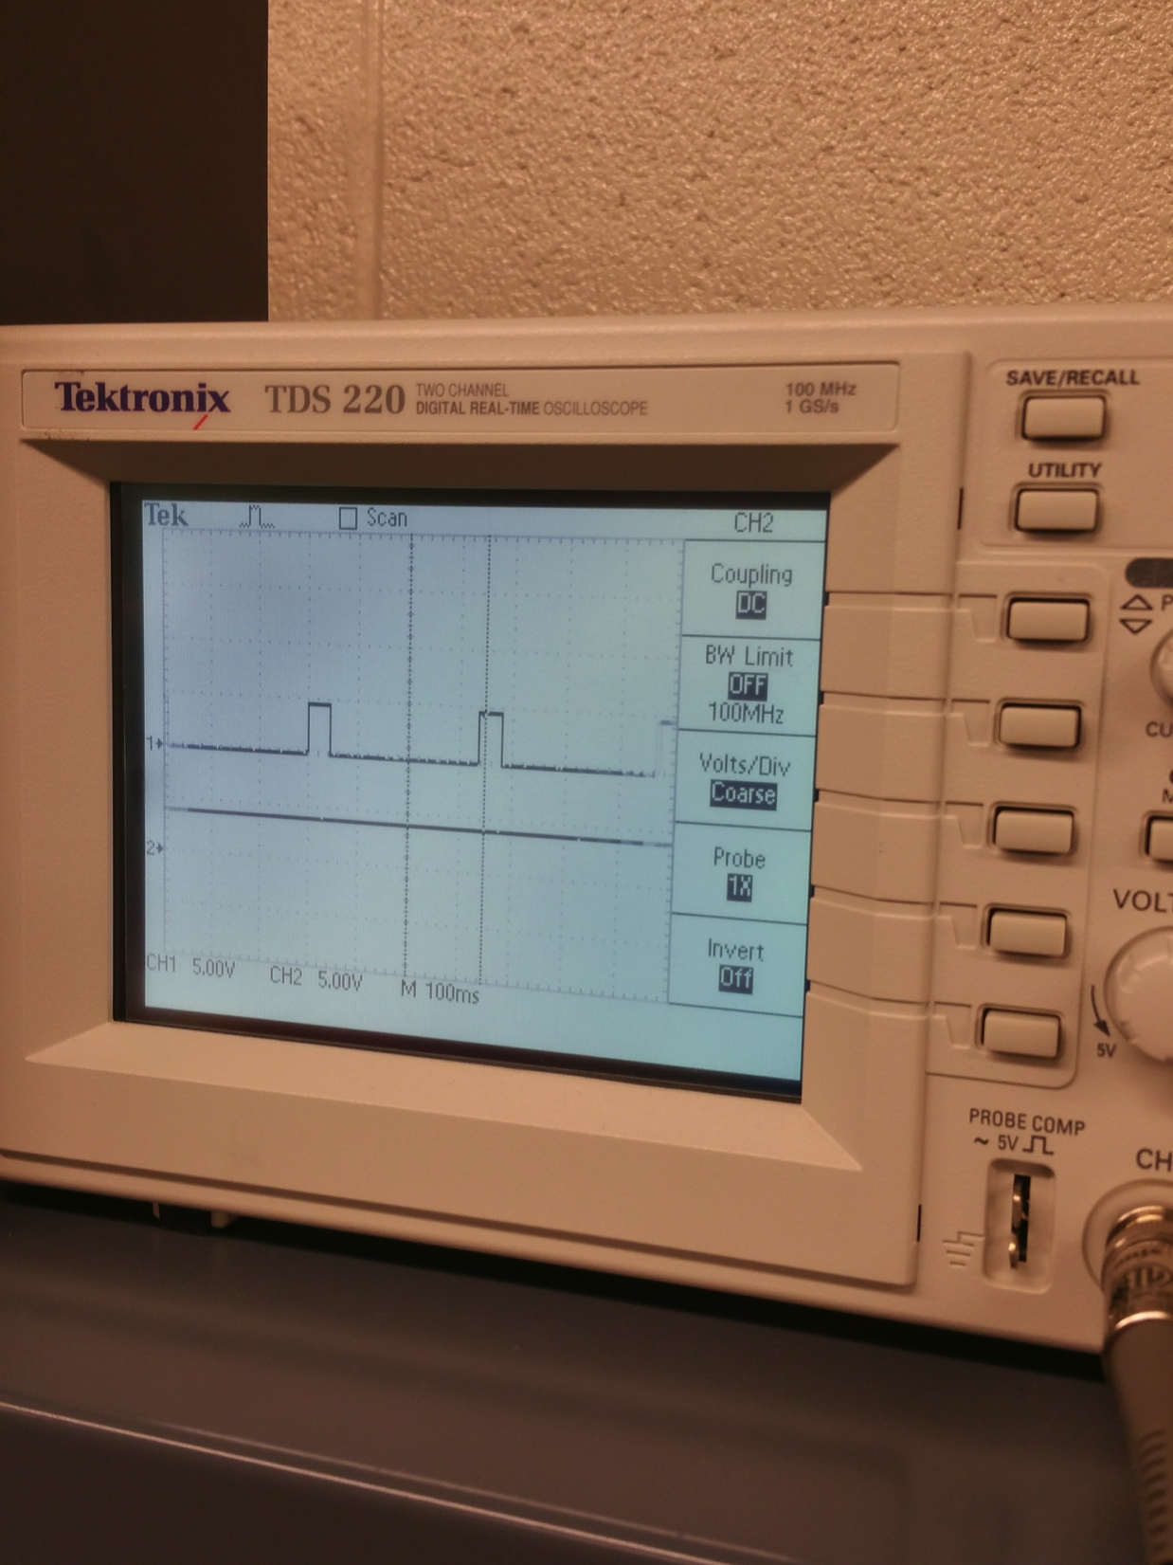
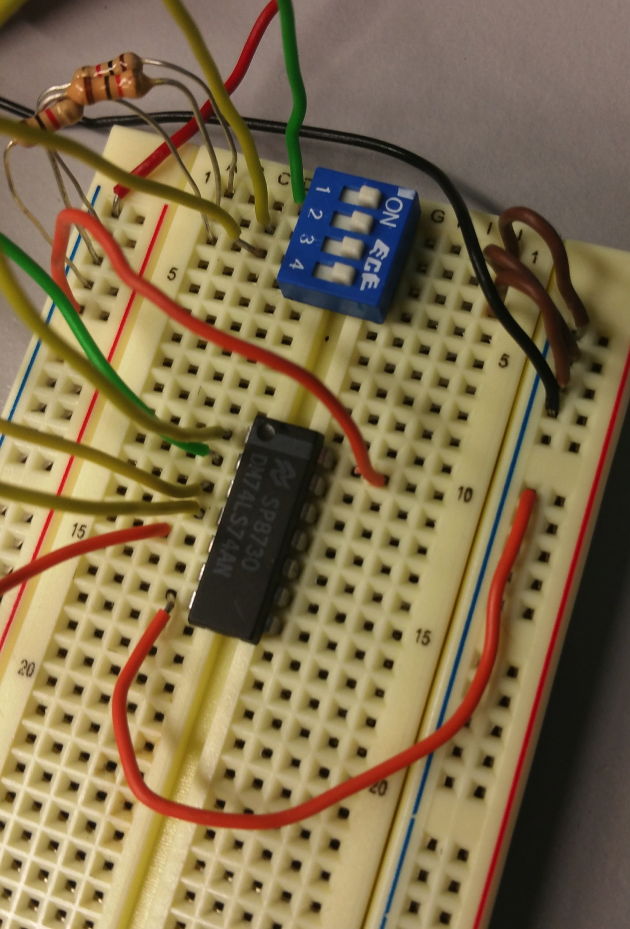
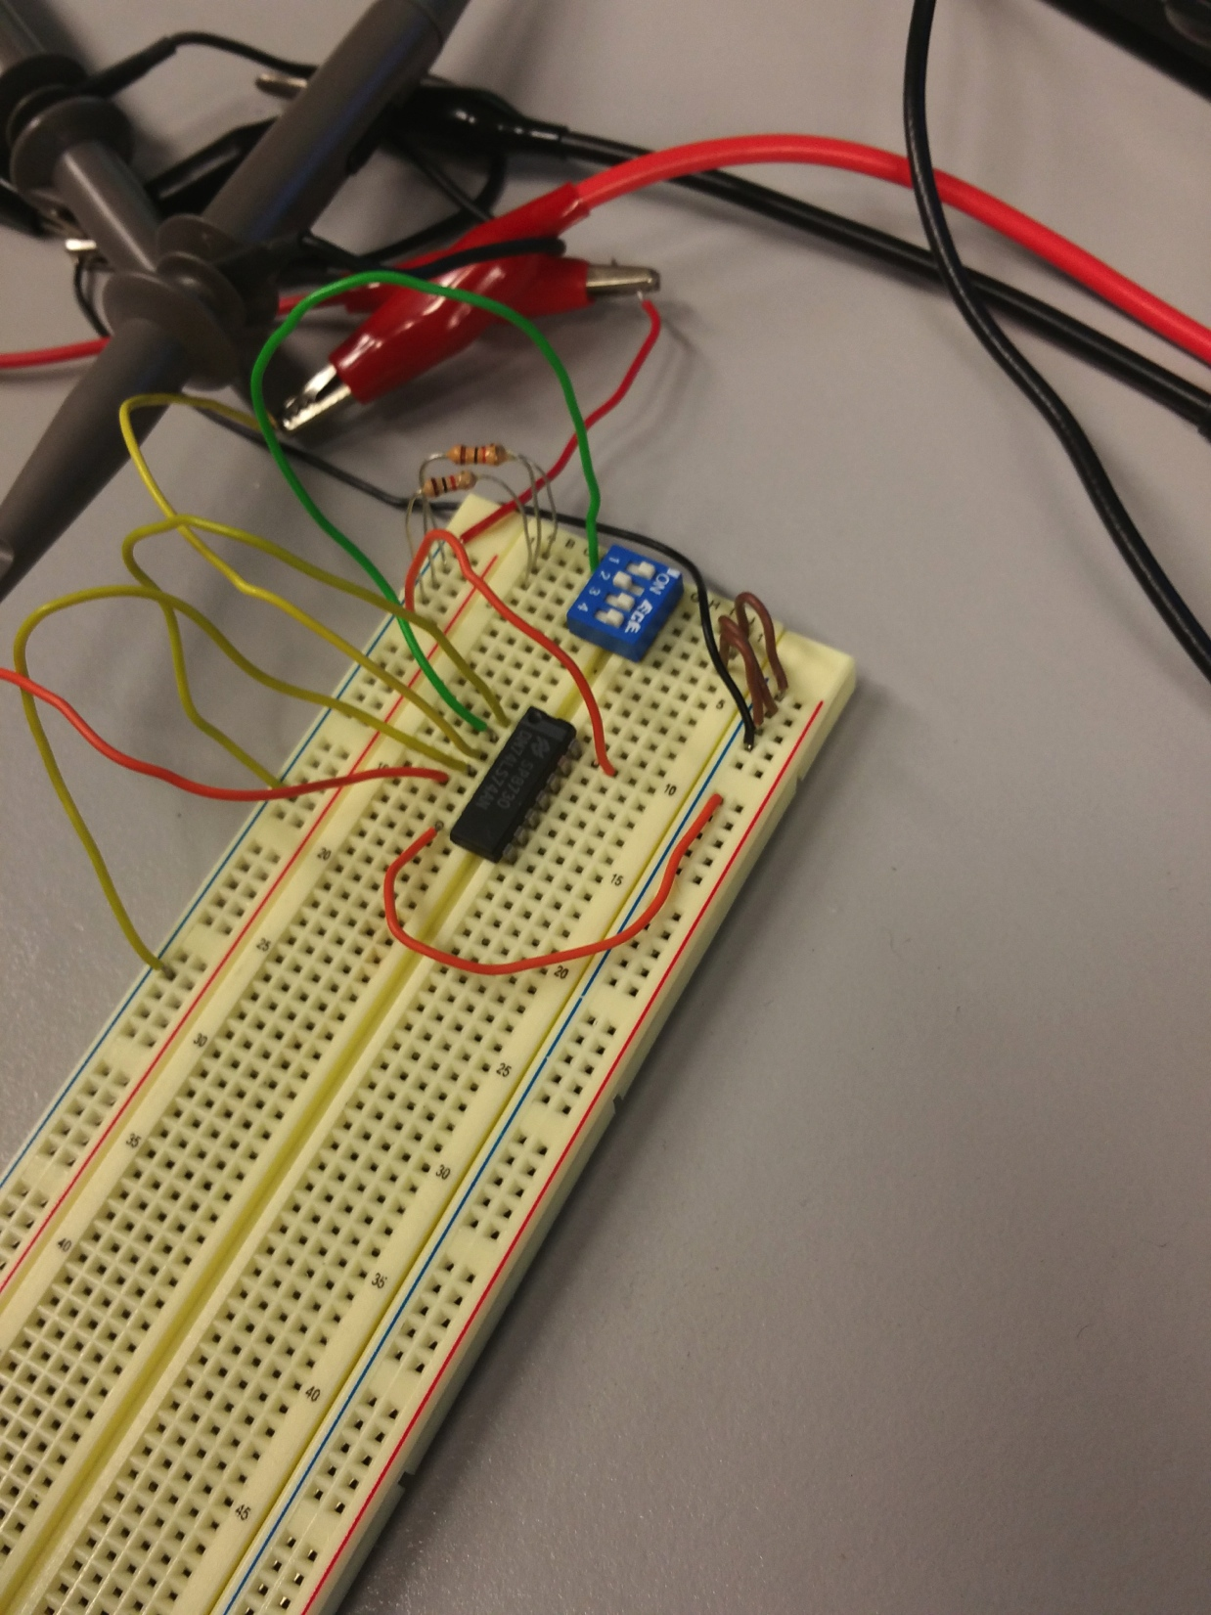
Pictures

Slide 40
conclusion
The Q output always takes on the state of the D input at the moment of a rising clock edge or falling edge if the clock input is active low) .The output takes the value of the D input or Data input, and Delays it by one clock count.
The D flip-flop follow the input D but cannot make the required transitions unless it is enabled by the clock. If the clock is low when a transition in D occurs, the tracking transiton in Q occurs at the next upward transition of the clock.

Slide 41
Lab- 5

Slide 42
Objectives:
Design, Build and Test a JK Flip Flop Lab

Slide 43
Equipment and Parts:
5 Volt DC Power Supply
Oscilloscope
Function Generator
Breadboard
Wires
74LS00
LED
Switch
(3) 10k Resistors
DC Power Supply
Brand: RSR
Model #: HY1802D
SN: 369996

Slide 44
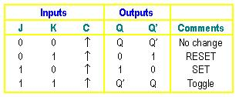
Truth table

Slide 45
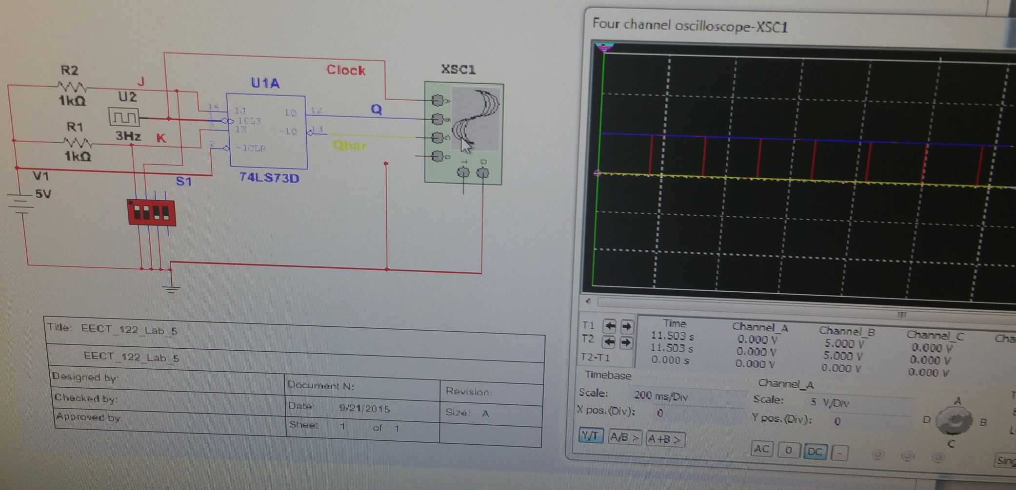
schematic

Slide 46
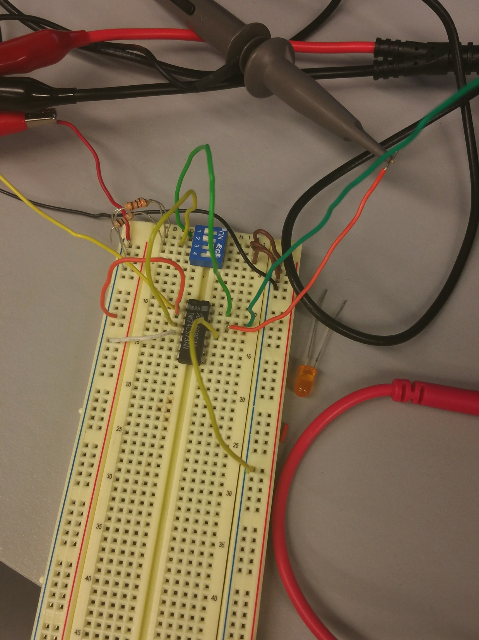
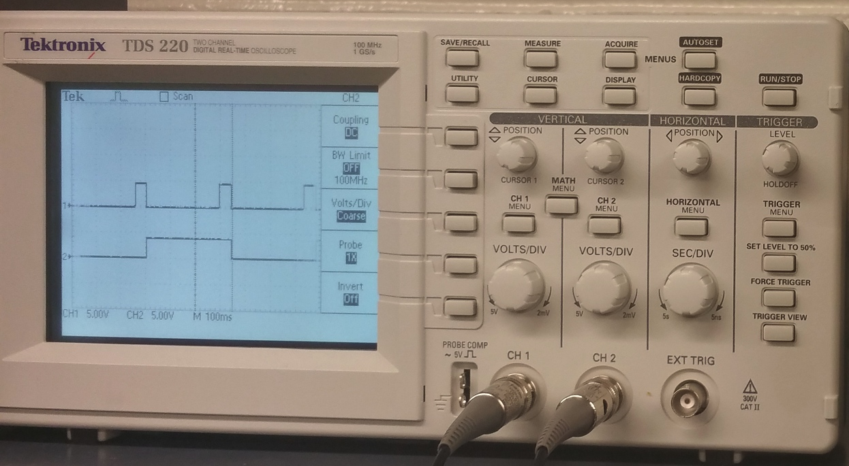
pictures

Slide 47
conclusion
The JK flip flop Q is ANDed with K and CP and Similarly Q’ is ANDed with J and CP, so that the flip-flop is cleared during a clock pulse only if Q’ was previously 1.
When both J and K are 0, the clock pulse has no effect on the output and the output of the flip-flop is the same as its previous value because the output of their respective AND gate becomes 0.
When J=0, K=1 this condition will reset the flip-flop because Q’ becomes 0. When J=1, K=0 this condition will set the Flip-flop because Q becomes 0. When both equal to 1 this will cause the output to complement again and again. This complement operation continues until the Clock pulse goes back to 0.

Slide 48
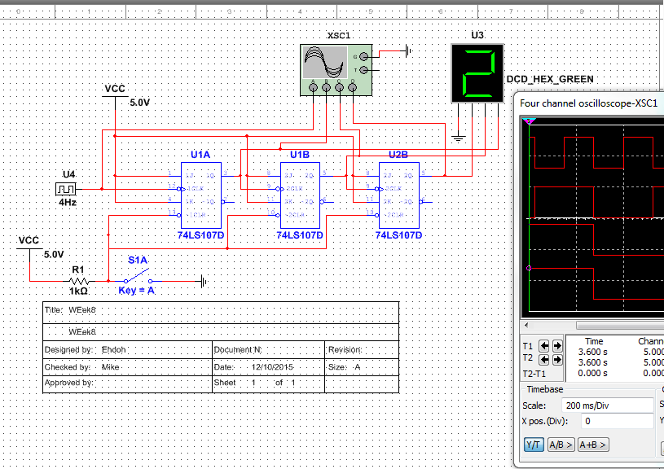
Three bit counter

Slide 49
Three bit counter
This was something we build on Multism that would help us on the next lab which is 4 bit binary counter.
Because there were 3 bit counters, it only count up to 9.
I’m guessing that the more bit there are, the more count you will have.

Slide 50
Lab- 7

Slide 51
Objectives:
Build 4 Bit counter (synchronous).

Slide 52
Equipment and Parts:
5 Volt DC Power Supply
Oscilloscope
Function Generator
Breadboard
Wires
74LS08, 74LS73
LED Bar
10k Resistors
DC Power Supply
Brand: RSR
Model #: HY1802D
SN: 369996

Slide 53
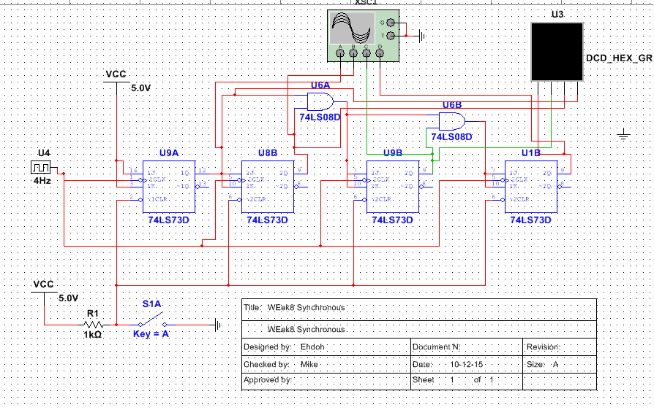
schematic

Slide 54
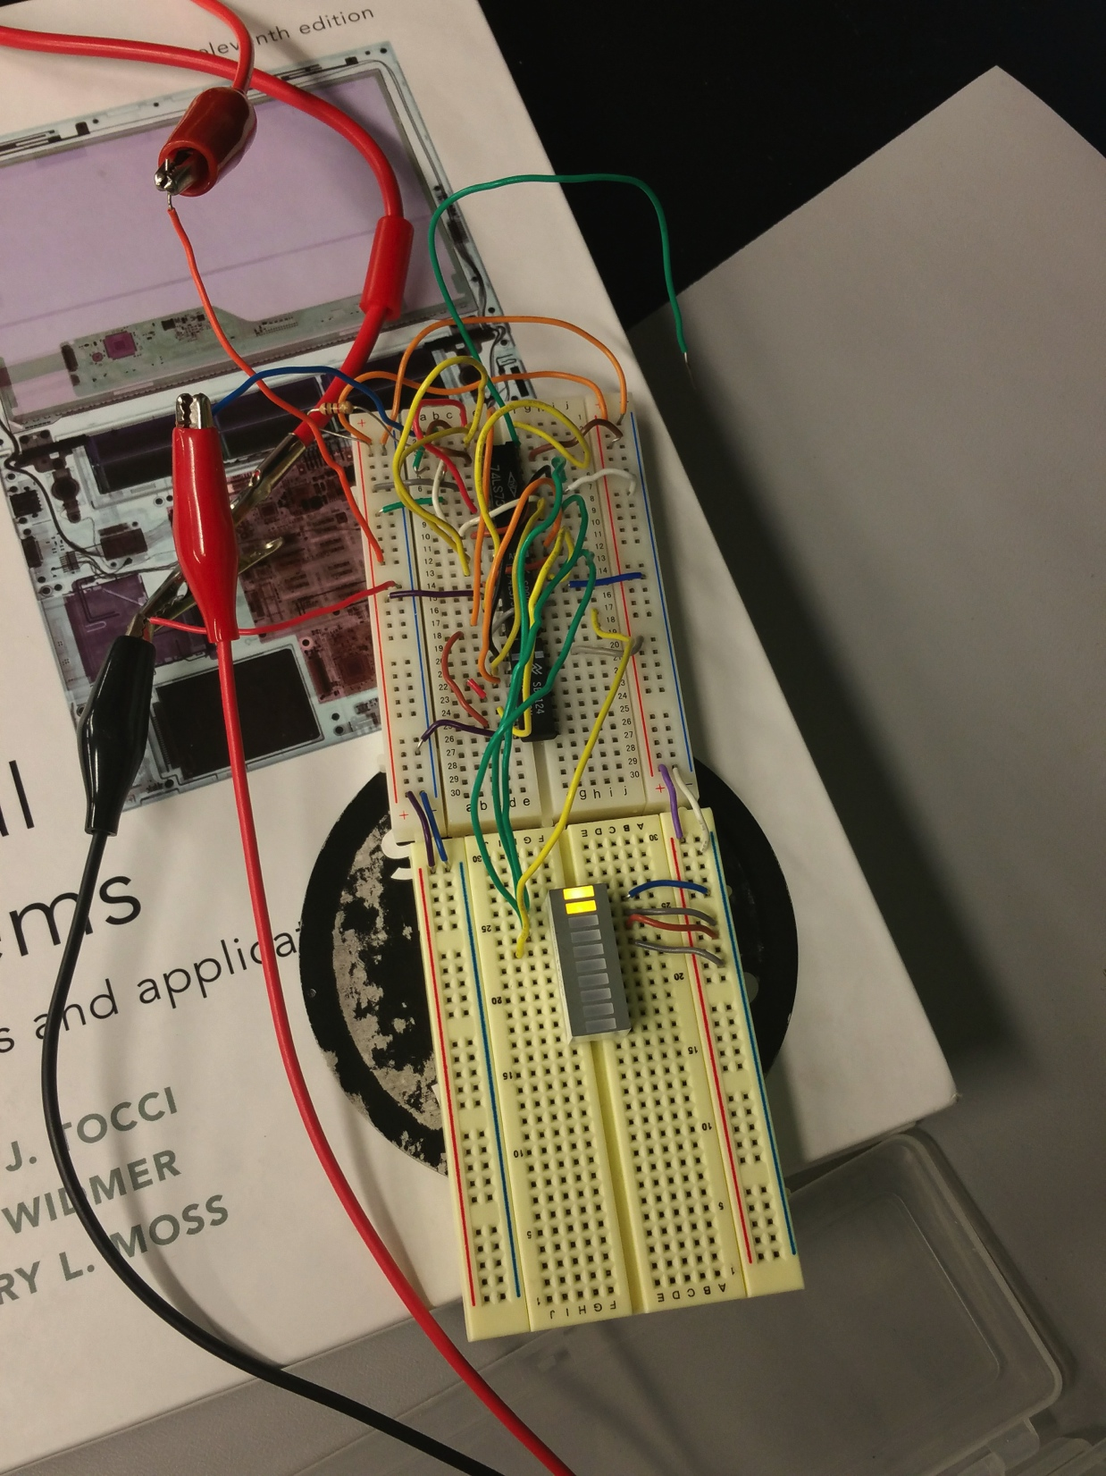
Picture

Slide 55
Conclusion
The clock inputs of all the flip-flops are connected together and are triggered by the input pulses.
All the flip-flops change state simultaneously in parallel.
A simple way of implementing the logic for each bit of an ascending counter is for each bit to toggle when all of the less significant bits are at a logic high state. For example, bit 1 toggles when bit 0 is logic high; bit 2 toggles when both bit 1 and bit 0 are logic high; bit 3 toggles when bit 2, bit 1 and bit 0 are all high; and so on.

Slide 56
Lab- 8

Slide 57
Objectives:
Design, built and test a Mod 12.

Slide 58
Equipment and Parts:
5 Volt DC Power Supply
Oscilloscope
Function Generator
Breadboard
Wires
74LS08, 74LS73
LED Bar
10k Resistors
DC Power Supply
Brand: RSR
Model #: HY1802D
SN: 369996

Slide 59
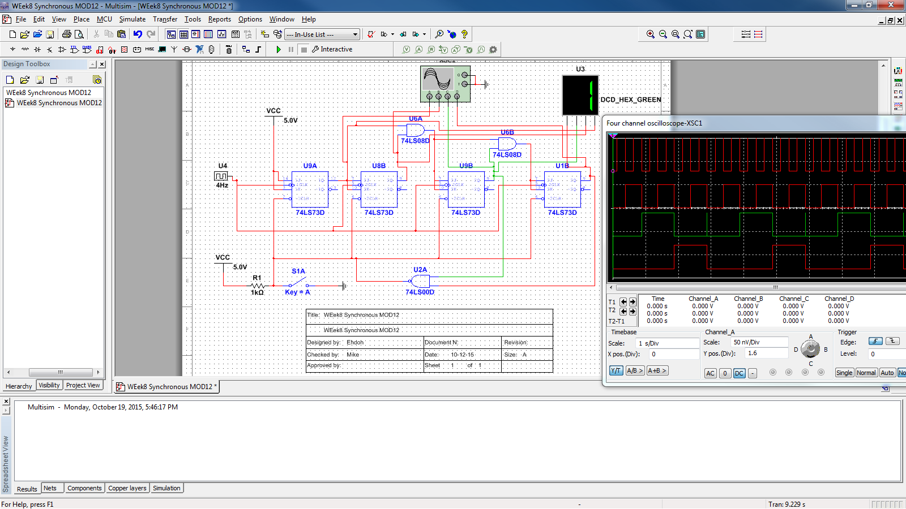
Schematic

Slide 60
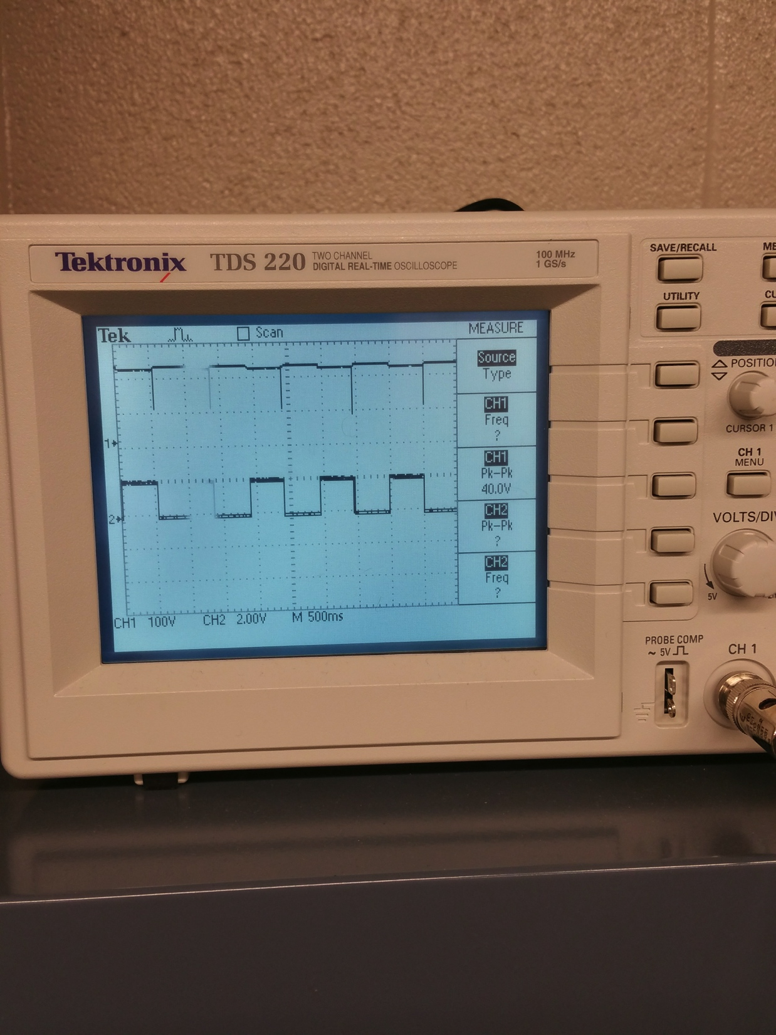
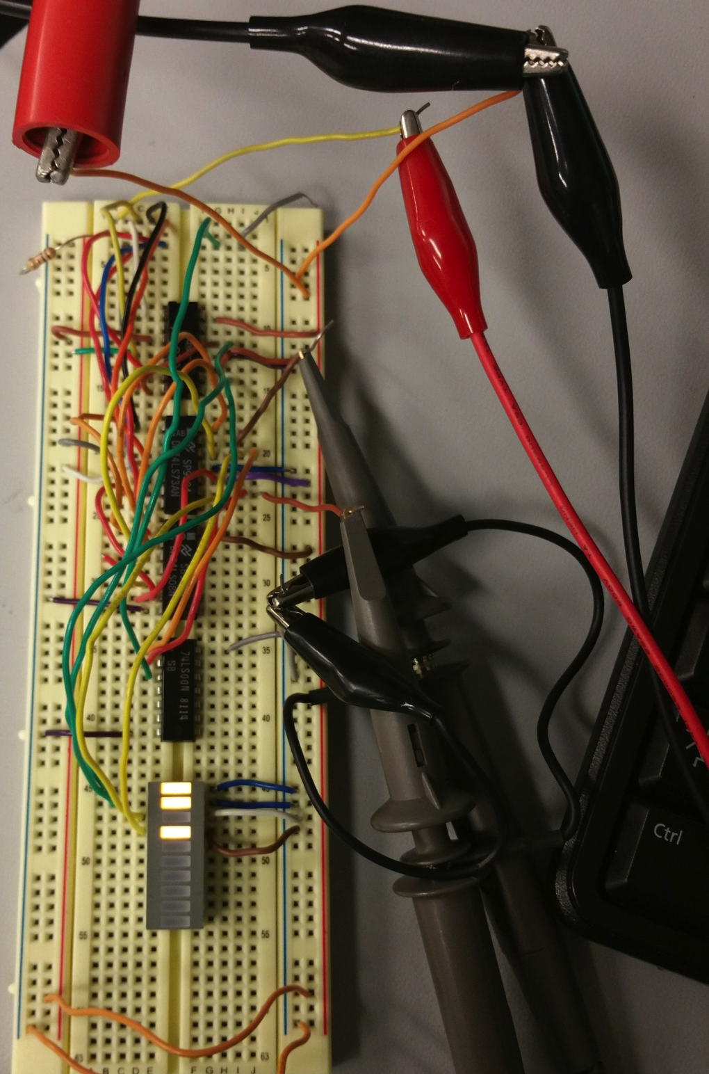
pictures

Slide 61
Troubleshooting
After everything was wired up in the circuit, it didn’t work as expected and I couldn’t figure out why.
I’ve spend a good amount of time trying to figure out by at first looking at the schematic to make sure I hooked up everything correct and I was sure I did hook it up right but still did not work.
My second thought was wondering if the chips was bad but since the wire was all over the chips, I didn’t want to bother to replace another chips because it was a lot of wiring to do which I did not want to repeat.
The final thought was if to use a seven segment display instead of currently using the LED Bar which I also looked at the datasheet to make sure the pin I used was correct but ended up not replacing it with seven segment display because I didn’t think it wouldn’t make any different and also I would have to pull up the datasheet for the pins and it was closed to the end of the night so I just called it a night.

Slide 62
Conclusion
Same Lab as the previous one except instead of counting from 0 to 15 , this lab is to modify it to count from 0-12.
Additional to the lab, a 2 input NAND gate is added to the circuit to make the count to stop at 12 and start over.

Slide 63
Lab- 10

Slide 64
Objectives:
Develop a model for 74185

Slide 65
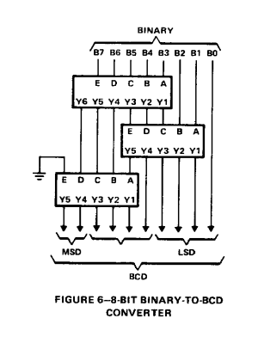
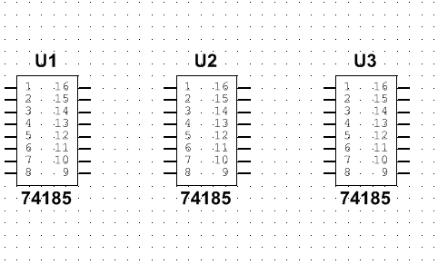
Pictures

Slide 66
conclusion
Having problem on this because I had no idea what was going on so I was just searching and looking for clue on internet.
What I had done so far was building the 74LS185 chip on Mulitsm and I believe what I supposed to do was to hook the 3 chips up following the figure on the datasheet I found but didn’t have a chance to get it done.

Slide 67

Lab- 12

Slide 68
Objectives:
Xilinx CPLD effort
Use the PLDT-3 Trainers, do the experiments in the manual.

Slide 69
Parts
Solderless Breadboard
74LS00 TTL Quad-2 Intergrated Circuit
PLDT-3 with power module

Slide 70
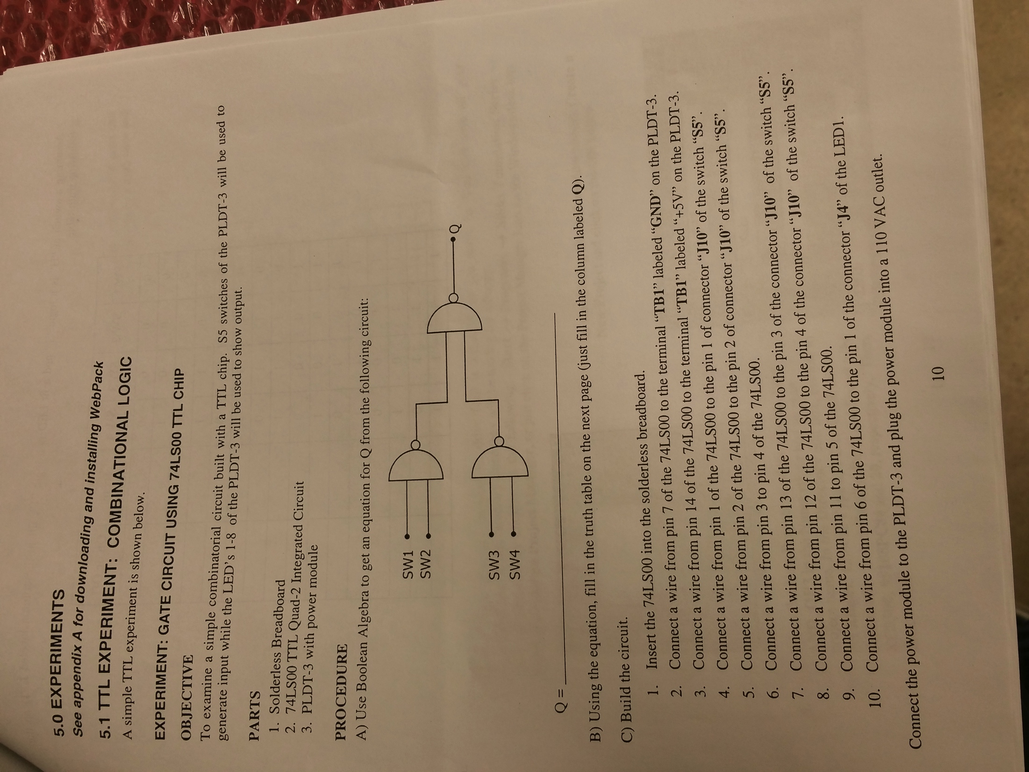
Schematic for 1st experiment

Slide 71
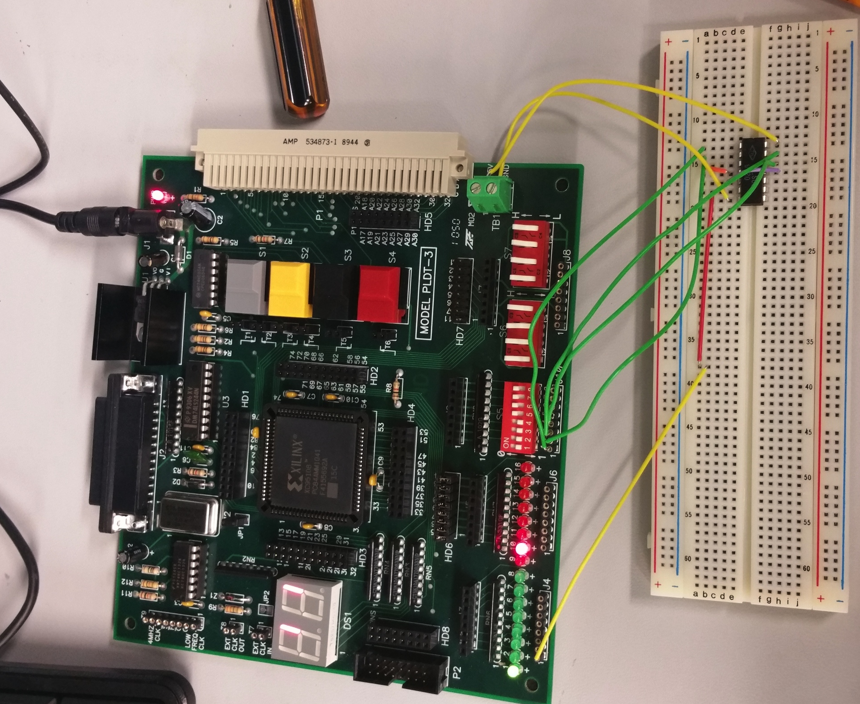
Picture

Slide 72
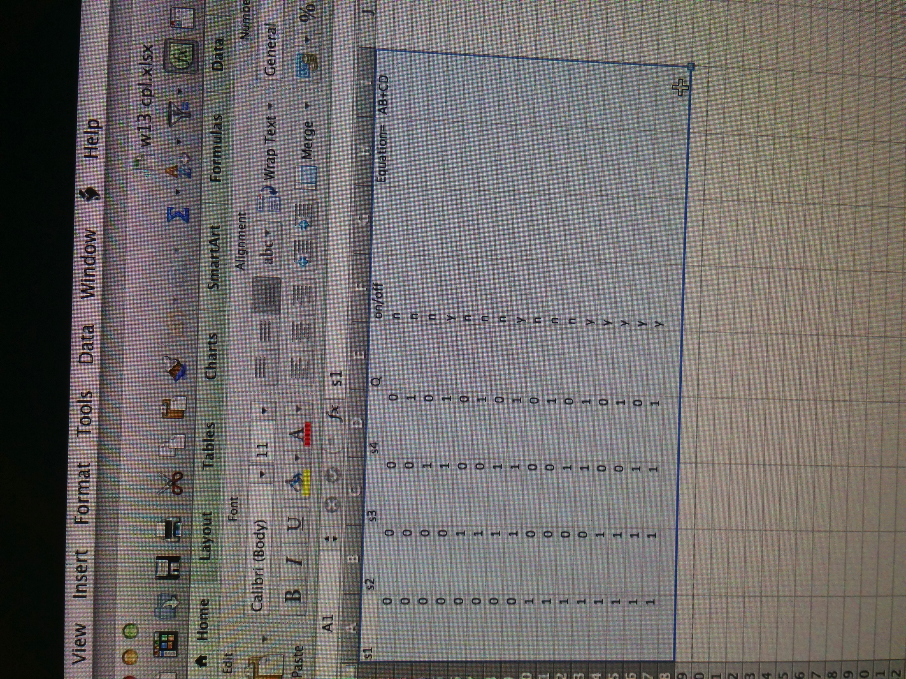
result

Slide 73
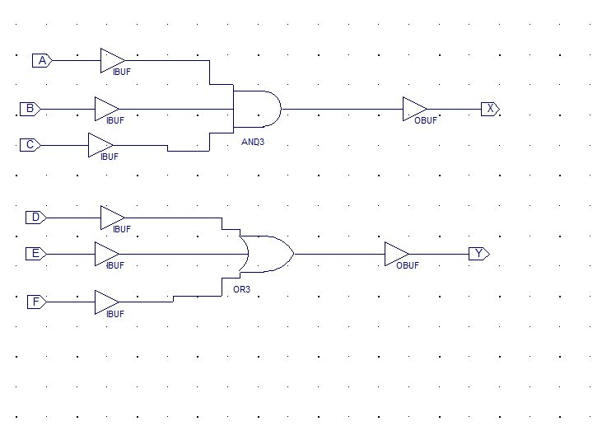
Schematic for 2nd experiment

Slide 74
Conclusion
First experiment was simple. The instructions were easy to follow and the experiment was like the first week lab we did which is testing the chip.
The instructions for experiments 2 was tricky because it was hard to follow and not understandable. Also we couldn’t get the experiment done because we don’t have the software for it.

Slide 75
Lab- 13

Slide 76
Objectives:
Do some exercises in the Arduino book.

Slide 77
1st Exercise
Parts:
  2 switches, breadboard, Arduino, wires, and LED
Objective:
  This exercise is called “get to know your tools”. It is to builda simple circuit with some switches , and LED, and a resistor.

Slide 78
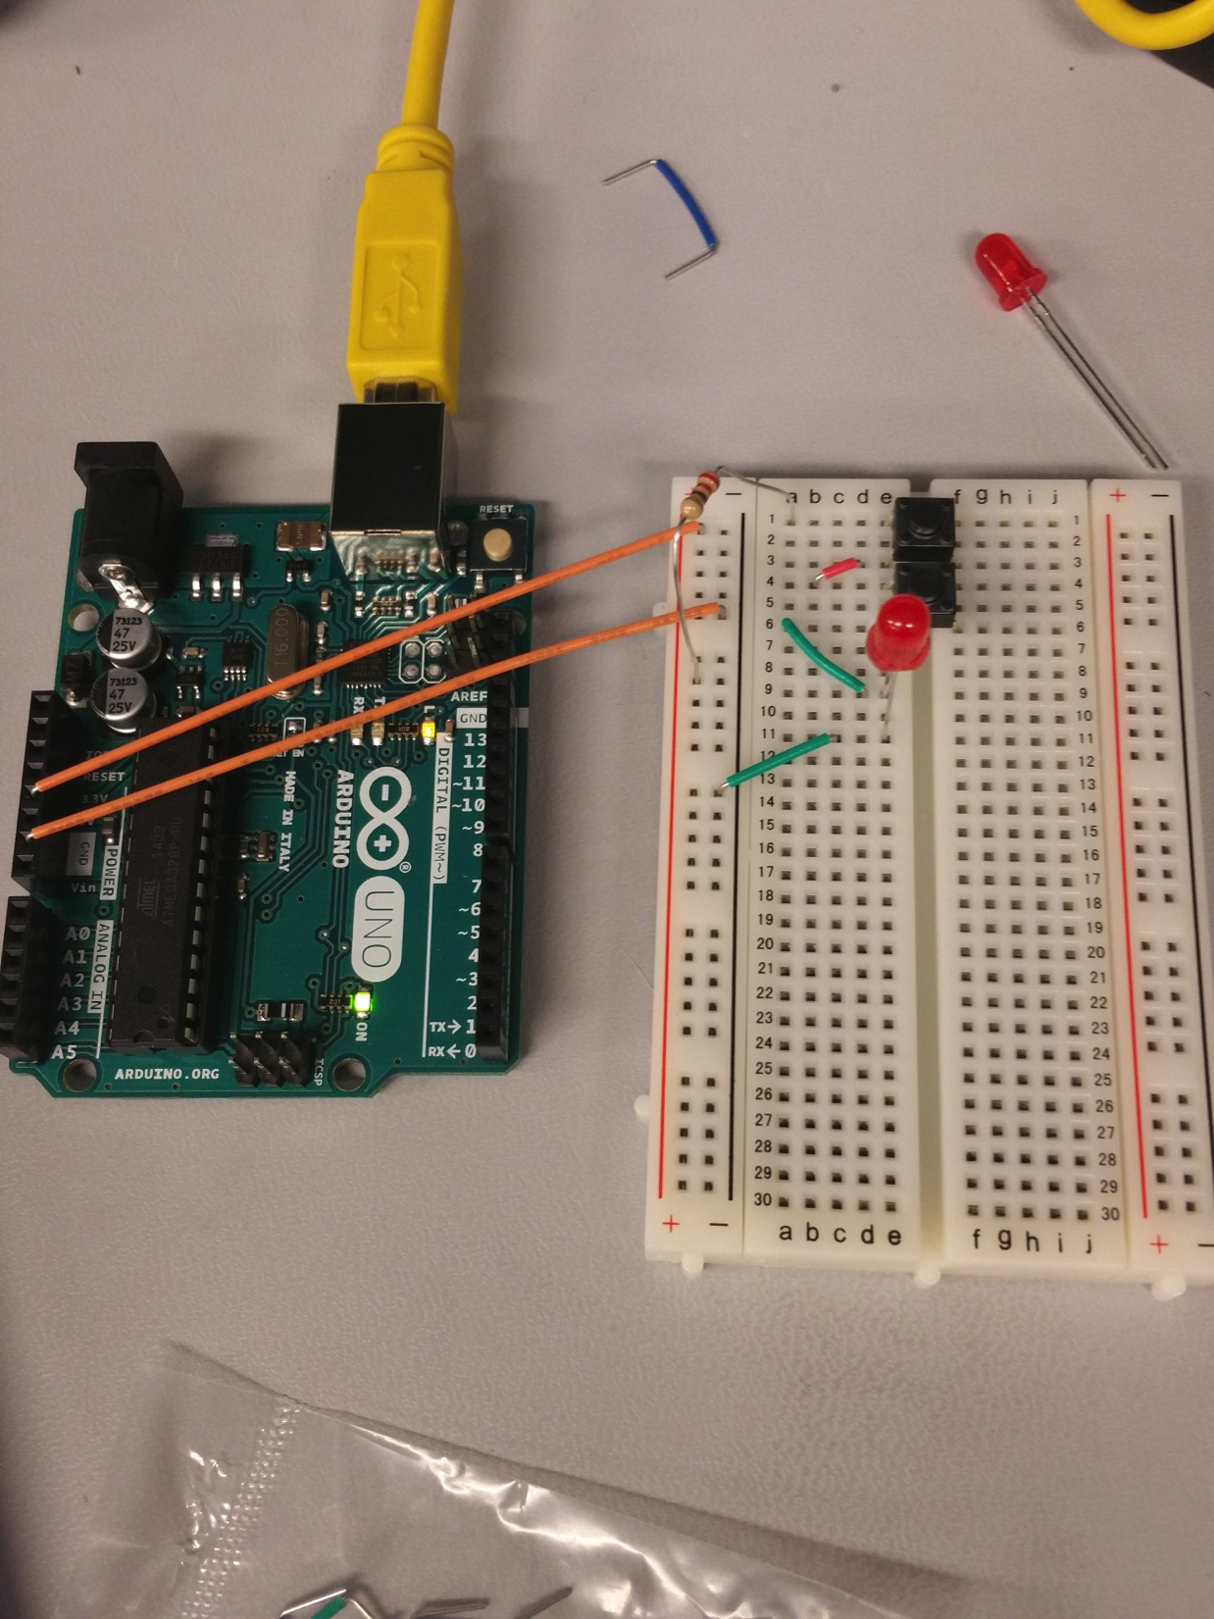
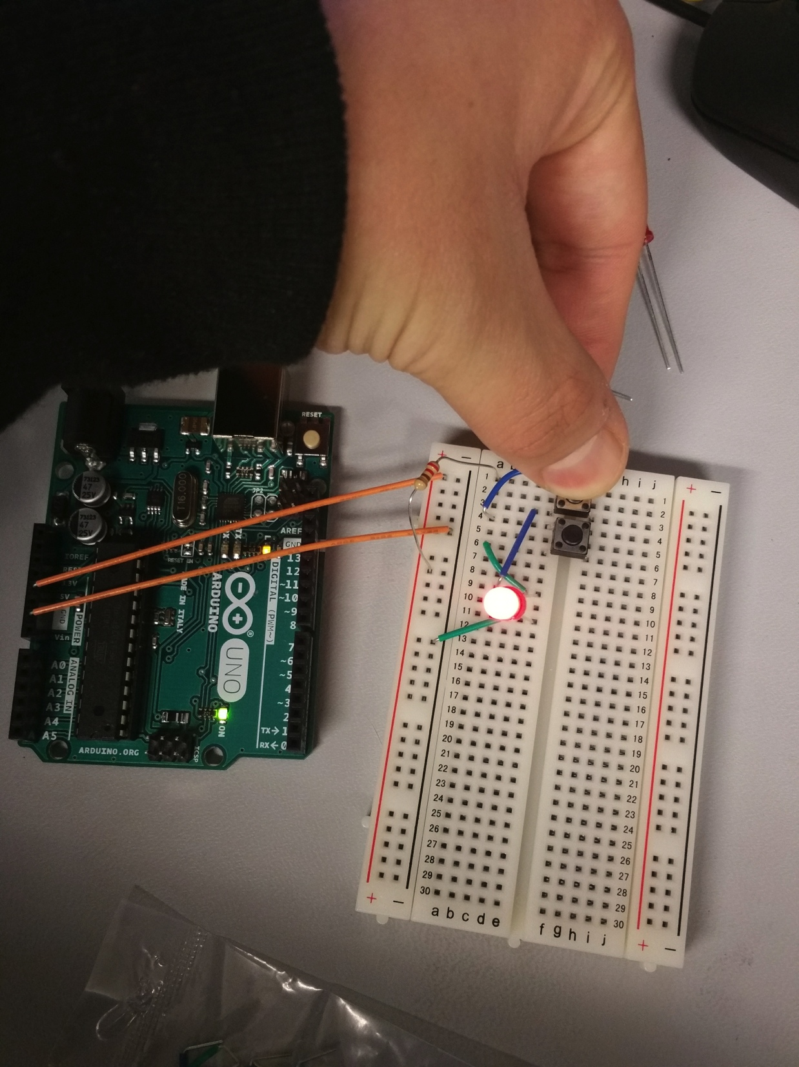
Pictures

Slide 79
2nd Exercise
Parts:
  switch, resistors, breadboard, Arduino, wires, and 3 LEDs
Objective:
  This exercise is called “Spaceship Interface”. The exercise is to make a cool control panel with a switch and lights that turn on when you press the switch.

Slide 80
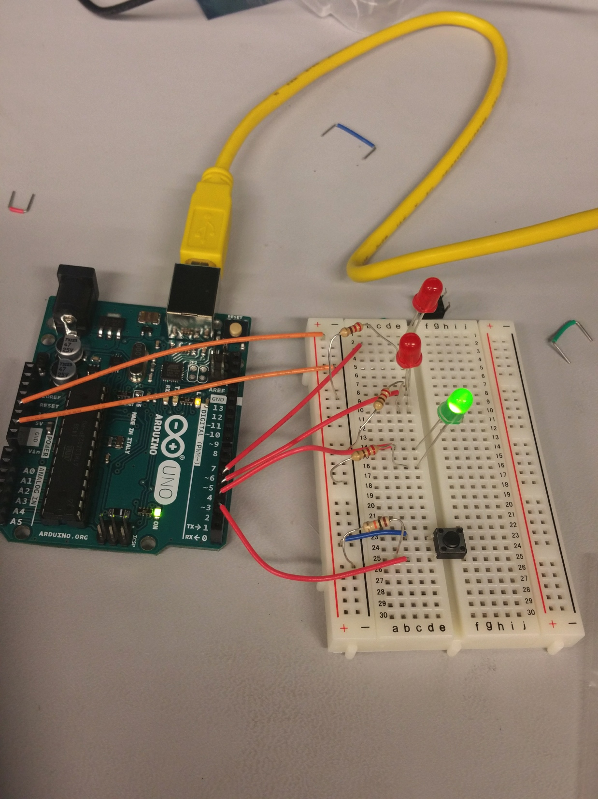
Picture

Slide 81
3rd Exercise
Parts:
  GEL, resistors, breadboard, Arduino, wires, and Tri-Color LED, Photoresistors
Objective:
  This exercise is called “Color Mixing Lamp”. The exercise is to create a lamp that smoothly changes colors depending on external lighting conditions.

Slide 82
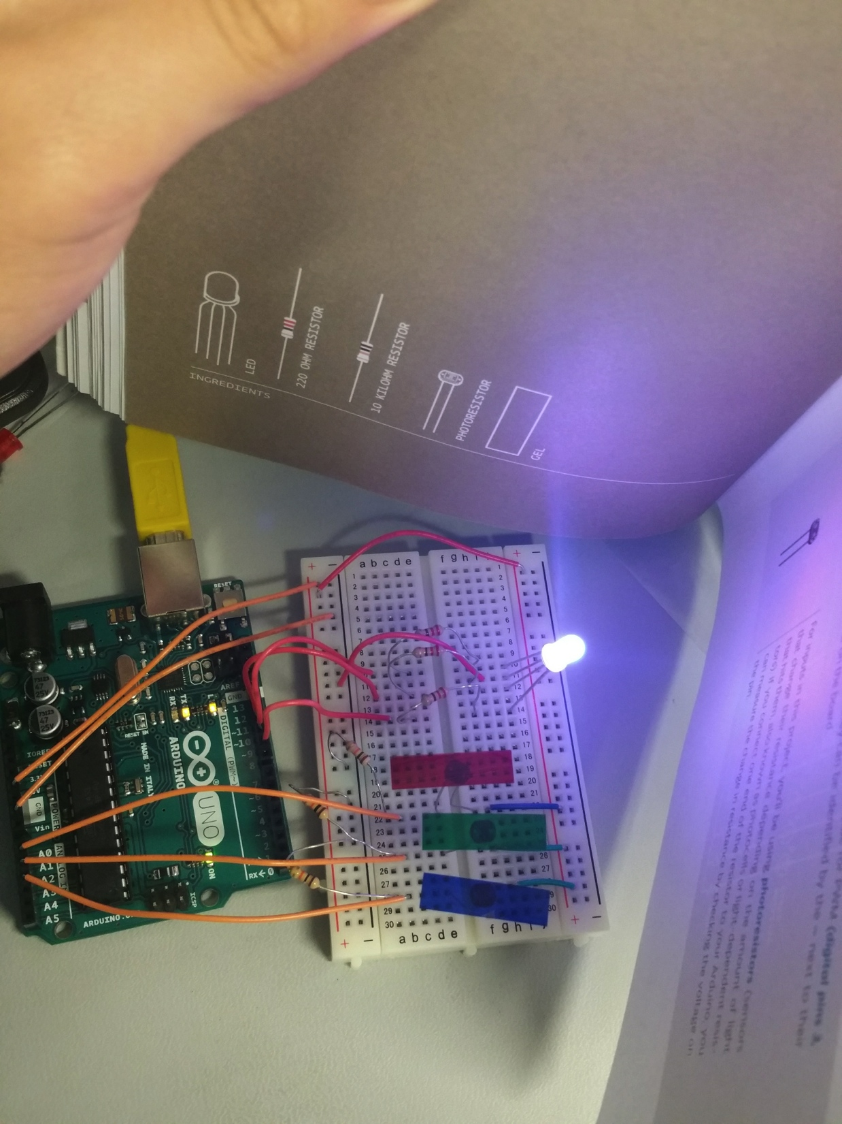
Picture

Slide 83
Conclusion
These exercises were pretty cool. It’s a beginner level that expose to you what arduino is and how to write code and program it.
The first exercise was the basic of electricity like how you can convert energy to do interesting things such as turning on lights and make a noise out of the speaker. The second exercise was a move on to controlling things with your Arduino. The third exercise was the same as the second but it was a little more fun and you get expose to more command on coding.

Slide 84
Lab- 14

Slide 85
Objectives:
Find something cool to build using Arduino.

Slide 86
LED Music player
Parts
  Resistors, LEDS, wires, Arduino, breadboard, push button, and Piezo (speaker)

Slide 87
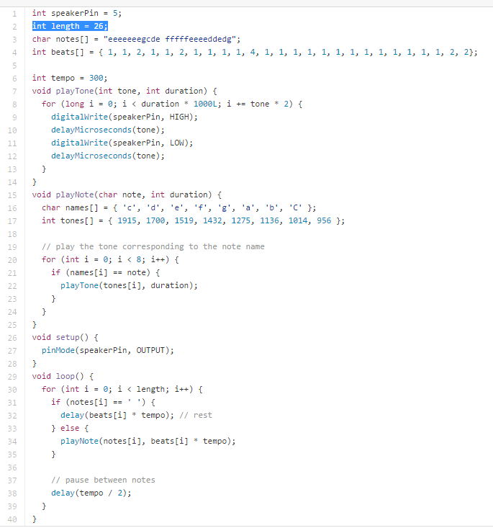
Coding

Slide 88
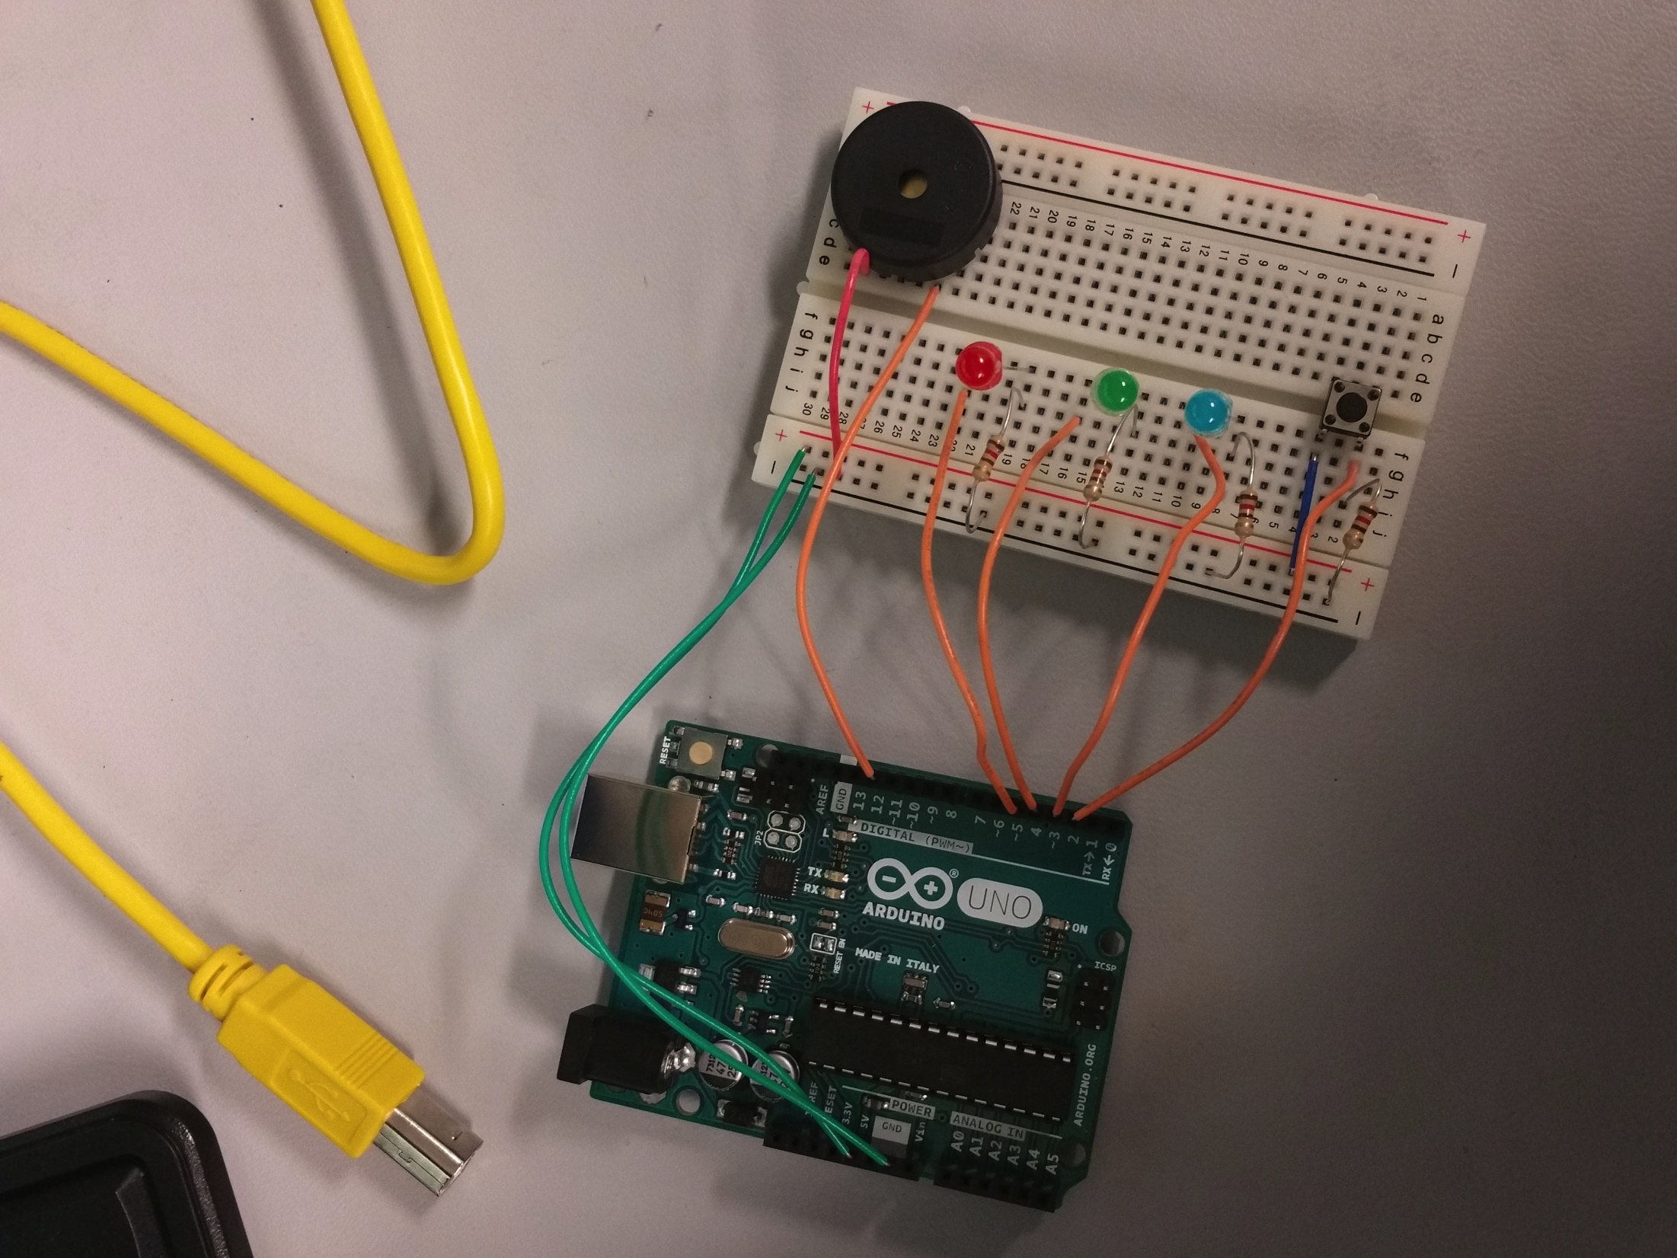
Picture

Slide 89
troubleshooting
Got the sound/ music working but the problem was that the LED won’t blink while the melody is playing and also the push button that supposed to start/stop the circuit didn’t work.
The problem was I used the code on one video I found which was the whole idea but I needed to create something on my own so I thought if I take out the melody part and replace with another which was Jingle Bell, and that would be all I need. So I have two codes from different websites that I put together which created a whole mess that I couldn’t figure out to get it work even I noticed that the way the codes were wrote differently.

Slide 90
conclusion
I’ve learned that I wouldn’t have much problem if I wrote my own code following the guide book and just looking at some ideas on internet on how some has done it.
I would be able to get it now if I am able to work on it and make it work like I want it to because it wouldn’t be as hard as figuring out how someone wrote it and the meaning of some command they use in there which I would do it differently.

Slide 91
Links to the code
https://github.com/Jianan-Li/super-saiyan/blob/master/LEDMusicPlayer/LEDMusicPlayer.ino
https://gist.github.com/elubow/7844436

